Slide 1


خطوات عملية للسعادة
Practical Steps to happiness
Website:
https://iloveallah.net
YouTube Channel:
https://www.youtube.com/channel/UCZDYWIWY1pMaGg4-iw3uz1w
YouTube Playlist:
https://www.youtube.com/playlist?list=PLNT8BTFvQYHLWc7EkqE0OYo1sRCuQwYzv

Slide 2
Review and Follow-up

Slide 3
Happiness is in the heart/Spirit
Ibn al-Qayyim reported: Shaykh Ibn Taymiyyah, may Allah have mercy on him, said to me once, “In this life there is a paradise, who did not enter it, will not enter the paradise in the hereafter … what can my enemies do to me? My paradise and my garden are in my heart wherever I go and they are never separated from me. If I am imprisoned, then it is seclusion for worship. If I am killed, then it is martyrdom. If they expel me from my land, then it is tourism.”
Source: al-Wābil al-Ṣayyib 1/48
عن ابن القيم قَالَ وَقَالَ لِي شَيْخَ الْإِسْلَامِ ابْنَ تَيْمِيَّةَ رحمه الله مَرَّةً إنّ في الدينا جنة من لم يدخلها لم يدخل جنة الآخرة ... مَا يَصْنَعُ أَعْدَائِي بِي أَنَا جَنَّتِي وَبُسْتَانِي فِي صَدْرِي أَيْنَ رُحْت فَهِيَ مَعِي لَا تُفَارِقُنِي أَنَا حَبْسِي خَلْوَةٌ وَقَتْلِي شَهَادَةٌ وَإِخْرَاجِي مِنْ بَلَدِي سِيَاحَةٌ
1/48 الوابل الصيب من الكلم الطيب

Slide 4
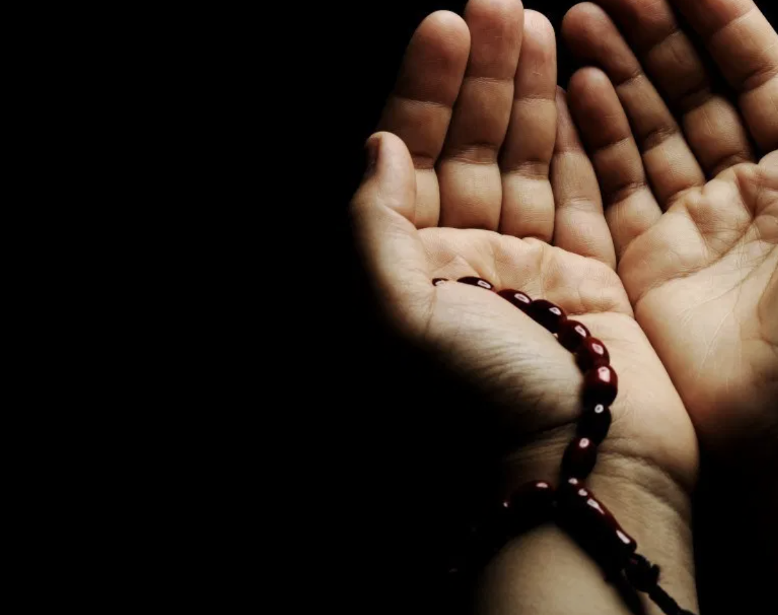
1. Ask Allah for help

Slide 5
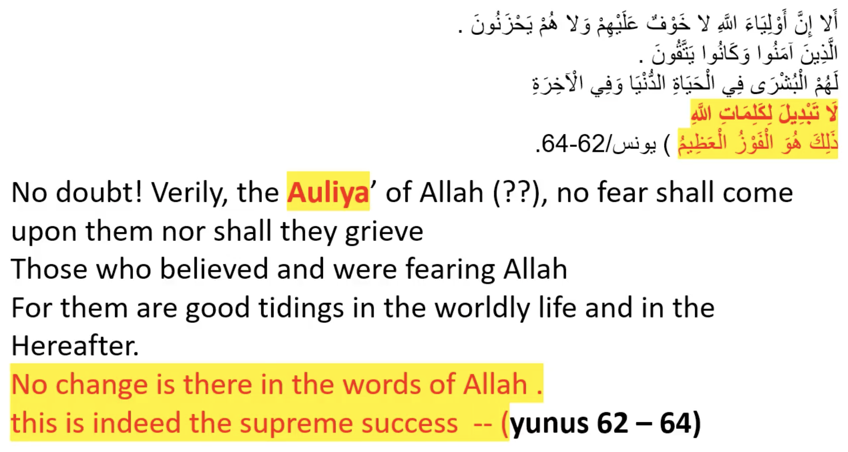

Slide 6
قال رسول الله صلى الله عليه وسلم‏:‏ ‏"‏إن الله تعالى قال‏:‏ ‏"‏من عاد لي وليَّا، فقد آذنته بالحرب، وما تقرب إلي عبدي بشيء أحب إليَّ مما افترضت عليه، وما يزال عبدي يتقرب إليَّ بالنوافل حتى أحبه فإذا أحببته كنت سمعه الذي يسمع به، وبصره الذي يبصر به، ويده التي يبطش بها، ورجله التي يمشي بها، وإن سألني، أعطيته، ولئن استعاذني، لأعيذنه‏"‏ ‏(‏‏(‏رواه البخاري‏)‏‏)‏‏.
Messenger of Allah (ﷺ) said, "Allah, the Exalted, has said: 'I will declare war against him who treats with hostility a pious worshipper of Mine. And the most beloved thing with which My slave comes nearer to Me, is what I have enjoined upon him; and My slave keeps on coming closer to Me through performing Nawafil (voluntary prayers or doing extra deeds besides what is obligatory) until I love him, (so much so that) I become his hearing with which he hears, and his sight with which he sees, and his hand with which he strikes, and his leg with which he walks; and if he asks Me something, I will surely give him, and if he seeks My Protection (refuge), I will surely protect him". [Al-Bukhari]

Slide 7
How was the duaa?
Were we able to make duaa, at least once a day?
Have we been complaining to Allah and asking for help?
How was the monologue with Allah?
If it was hard, this is because of the state of our heart. As we progress, our heart will get better.
The most important thing is to get the best of the opportunities Allah will give us. It might be the acceptance of our duaa

Slide 8
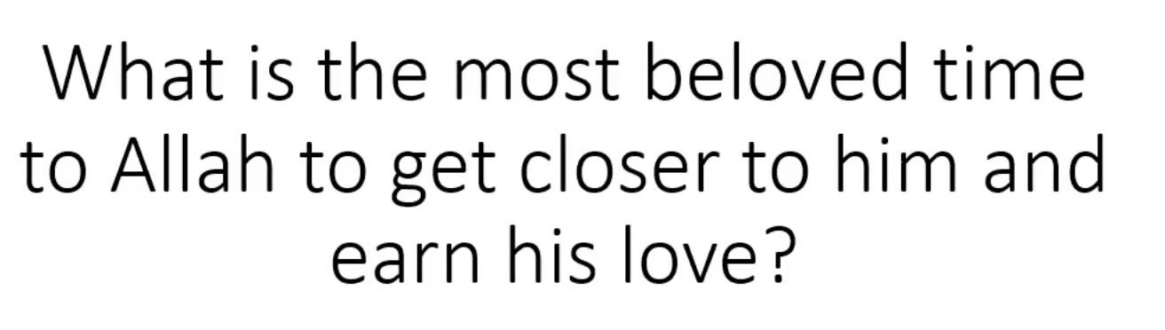

Slide 9
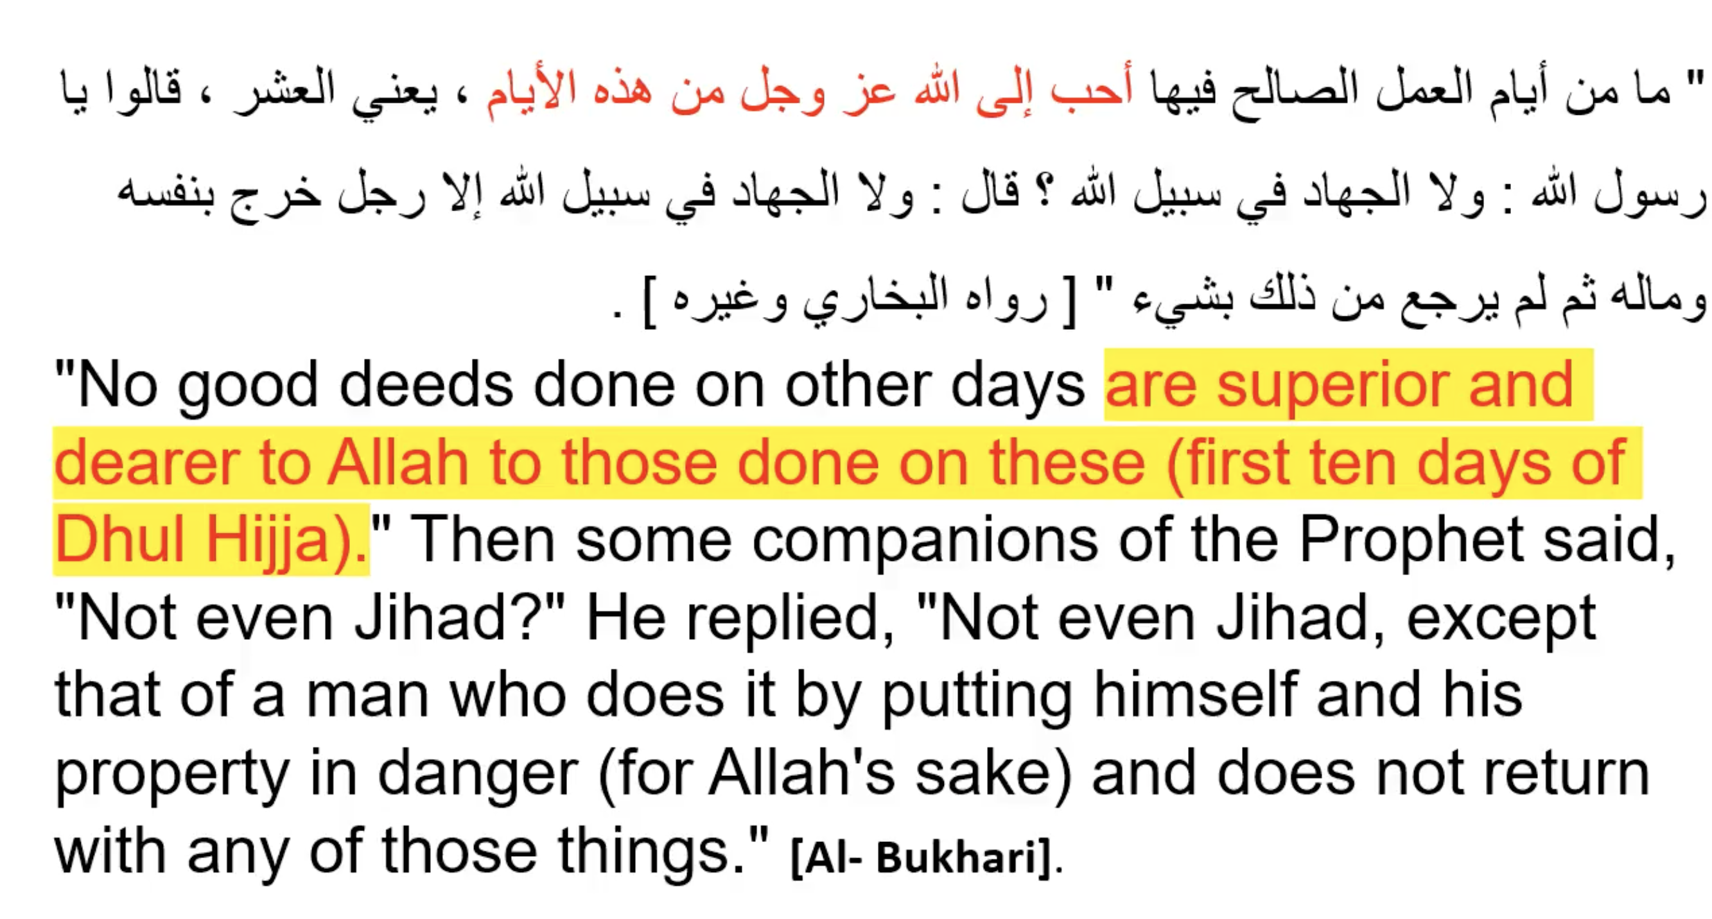

Slide 10
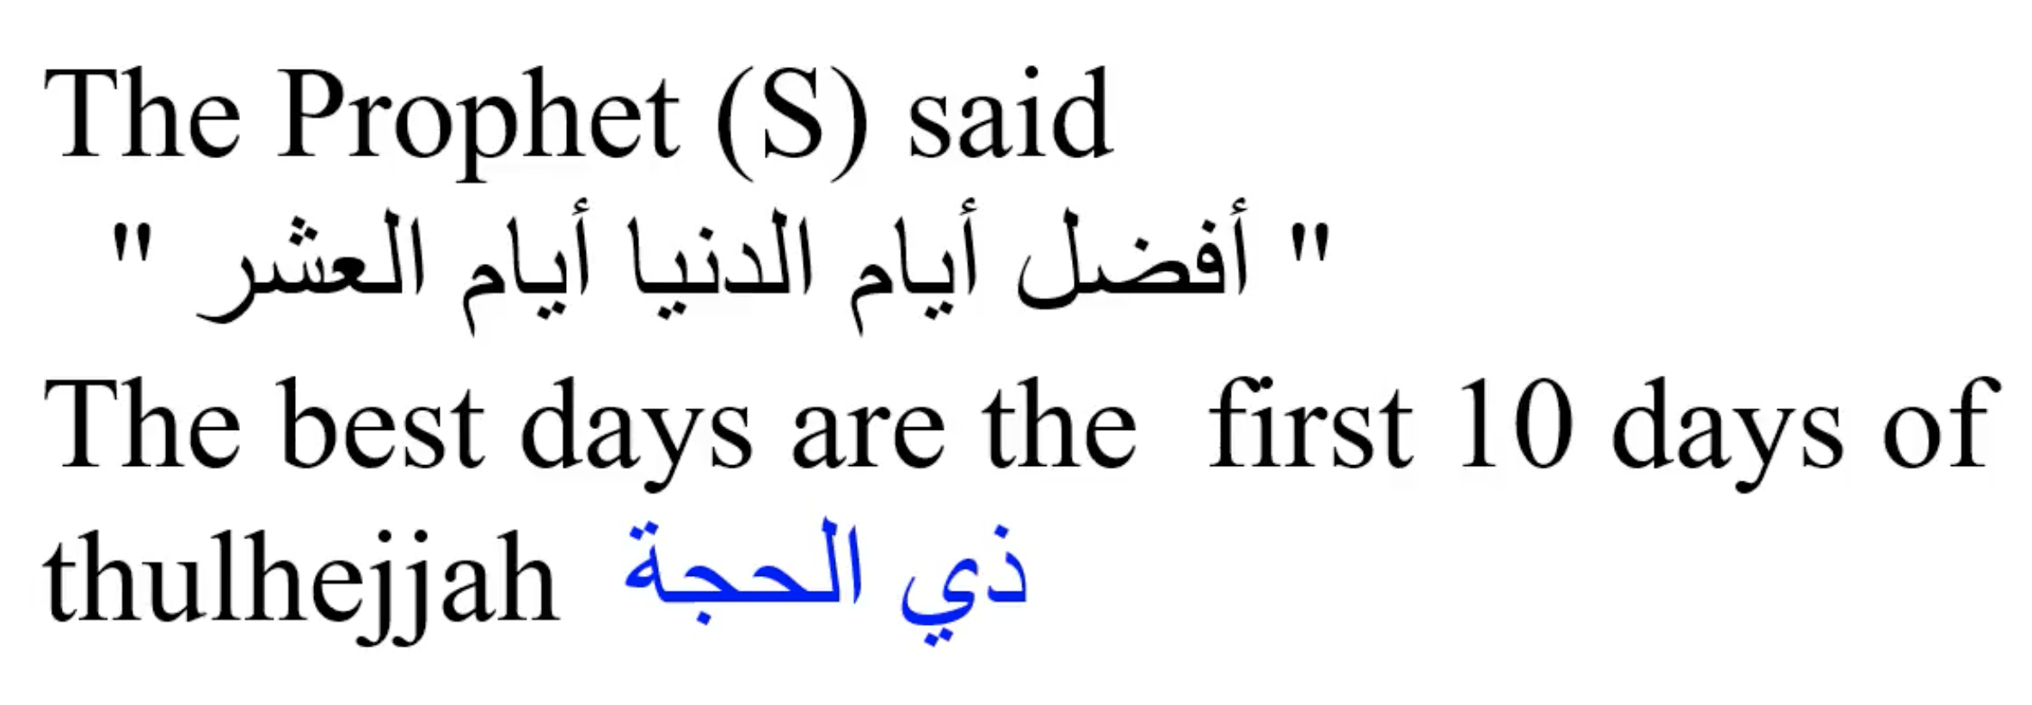

Slide 11
Allah swears by them in the Quran
" والفجر وليال عشر "
I swear By the Dawn and the ten nights
(the first ten of zulhijjah) Al Fajr

Slide 12
رواه الطبراني في الكبير عن محمد بن مسلمة برقم: 2398 وهو بتمامه : " إن لربكم في أيام دهركم نفحات، فتعرضوا لها لعله أن يصيبكم نفحة منها فلا تشقون بعدها أبدا "
Allah provides opportunities in the days of the year, so make sure to take the best out of them so that you will never grieve

Slide 13
قَالَ اللَّهُ عَزَّ وَجَلَّ إِذَا تَقَرَّبَ عَبْدِي مِنِّي شِبْرًا تَقَرَّبْتُ مِنْهُ ذِرَاعًا وَإِذَا تَقَرَّبَ مِنِّي ذِرَاعًا تَقَرَّبْتُ مِنْهُ بَاعًا - أَوْ بُوعًا - وَإِذَا أَتَانِي يَمْشِي أَتَيْتُهُ هَرْوَلَةً ‏"
Abu Huraira reported Allah's Apostle (ﷺ) as saying that Allah, the Exalted and Glorious, said:
When My servant draws close to Me by the span of a palm, I draw close to him by the cubit and when he draws close to Me by the cubit, I draw close to him by the space (covered) by two armspans, and when he comes to me walking, I go in a hurry towards him.
Reference | : Sahih Muslim 2675 e
In-book reference | : Book 48, Hadith 26

Slide 14
The best to get closer to Allah is doing the obligatory
Prayers, Parents, Wife, Husband, Neighbors …

Slide 15
Allah asked us to do Thikr on them - ومن فضائلها أن الله أمر فيها كثرة التسبيح التهليل والتكبير والتحميد فيها . " وَيَذْكُرُوا اسْمَ اللَّهِ فِي أَيَّامٍ مَّعْلُومَاتٍ":
And to celebrate the name of Allah during the appointed days (the first 10 of zulhijjah)
The easiest and the Most rewording worship
Can be done any where
  In the car
  Sleeping
  Setting
  In a meeting
  Waiting for the traffic light
  Walking
  Exercising
Can be done any time
  Morning
  Night
  With Wodow or without
It is done by heart
The least effort
The second medicine for hearts after Supplication
  The best 2 medications for your heart and your life.
The easiest
Gives you rewords the most
The worship that Allah loves the most
It does not cost you time
  Just do it in your spare time
  You do not have to dedicate time for it
It does not cost you effort

Slide 16
"Whoever says “ لا إلهَ إلاَّ اللَّهُ وَحْدَهُ لاَ شَرِيكَ لَهُ، لَهُ المُلْكُ وَلَهُ الحَمْدُ وَهُوَ عَلى كُلّ شَيْءٍ قَدِيرٌ (La ilah illa 'llah, wahdahu la sharik lah, lahu 'l mulku wa lahu 'l hamd, wa huwa ala kulli shay'in qadir) There is no god but Allah, alone, without any partner. The kingdom and praise belong to him and he has power over everything.” one hundred times a day, | 100 | كانَتْ لَهُ عِدْلَ عَشْرِ رِقابٍ، وكُتِبَتْ لَهُ مئة حَسَنَةٍ، ومُحِيَتْ عَنْهُ مئةُ سَيِّئَةٍ، وكانَتْ لَهُ حِرْزاً مِنَ الشَّيْطانِ يَوْمَهُ ذلكَ حتَّى يُمْسيَ، ولَمْ يَأتِ أحَدٌ بأفْضَلَ مِمَّا جاءَ بِهِ إِلاَّ رَجُلٌ عَمِلَ أكْثَرَ مِنْهُ. It is the same for him as: freeing ten slaves ($100,000 in charity). One hundred good actions are written for him and one hundred wrong actions are erased from him, and it is a protection from Shaytan for that day until the night. No-one does anything more excellent than what he does except someone who does more than that.

Slide 17
وعن أبي هريرة رضي الله عنه قال‏:‏ قال رسول الله صلى الله عليه وسلم‏:‏ ‏ "‏كلمتان خفيفتان على اللسان، ثقيلتان في الميزان، حبيبتان إلى الرحمن‏:‏ سبحان الله وبحمده، سبحان الله العظيم‏"‏ ‏(‏‏(‏متفق عليه‏)‏‏)‏‏.
Abu Hurairah (May Allah be pleased with him) reported:
The Messenger of Allah (ﷺ) said, "There are two statements that are light for the tongue to remember, heavy in the Scales and are dear to the Merciful: 'Subhan-Allahi wa bihamdihi, Subhan-Allahil-Azim [Glory be to Allah and His is the praise, (and) Allah, the Greatest is free from imperfection]'."
[Al-Bukhari and Muslim].

Slide 18
Zikr after Fajr Anas bin Malik narrated that : the Messenger of Allah said: "Whoever prays Fajr in congregation, then sits remembering Allah until the sun has risen, then he prays two Rak'ah, then for him is the reward like that of a Hajj and Umrah." He said: "The Messenger of Allah said: 'Complete, complete, complete.'" |  | The reward of Hajj (pilgrimage) and Umrah من صلى الصبح في جماعة ثم قعد يذكر الله حتى تطلع الشمس ثم صلى ركعتين كانت له كأجر حجة وعمرة قال قال رسول الله صلى الله عليه وسلم تامة تامة تامة

Slide 19
Day Of Arafaah
يوم عرفة

Slide 20
" صوم يوم عرفة يكفر سنتين ، ماضية ومستقبلة . . . " [ رواه مسلم
"Fasting the day of Arafa makes amends (Expiation) for the sins of the past year and the subsequent year".
[Muslim
The only warship that expiates the future
  A proof of how big is the reward (more than sins)
  See how much loves this day and rewards it
Expiates the previous year as well

Slide 21
Freedom from the hell fire
"مَا مِنْ يَوْمٍ أَكْثَرَ مِنْ أَنْ يُعْتِقَ اللهُ فِيهِ عَبْداً مِنَ النَّارِ، مِنْ يَوْمِ عَرَفَةَ، وَإِنَّهُ لَيَدْنُو ثُمَّ يُبَاهِي بِهِمُ الْمَلاَئِكَةَ، فَيَقُولُ: مَا أَرَادَ هَؤُلاَءِ؟“
'A'isha (Allah be pleased with her) reported Allah's Messenger (ﷺ) as saying:
There is no day when God sets free more servants from Hell than the Day of 'Arafa. He draws near, then praises them to the angels, … [Muslim]

Slide 22
The Best supplication and closer to acceptance ""أفْضَلُ الدُّعاءِ دعاءُ يَوْمِ عَرَفَةَ "
"The most excellent duaa and closer to acceptance is the duaa (supplication) on the Day of Arafa, ….'"

Slide 23
Plan for this week
Until next time isA
https://iloveallah.net/happiness/

Slide 24
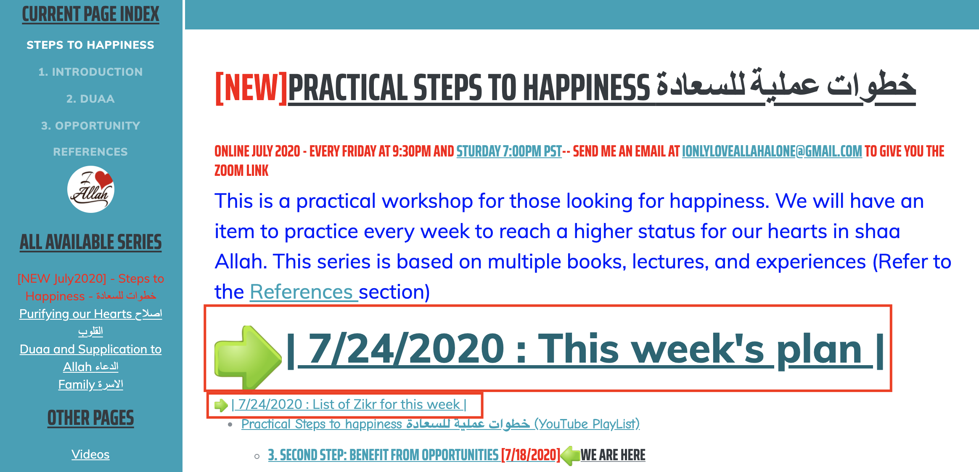
Plan for this Week
https://ILoveAllah.net/happiness - Until next session, isA

Slide 25
1. Duaa
This is our goal is to become Walye and have a happy life and a happy hereafter
Ask Allah in your language, at least, after each prayer and on Friday before Maghrib [Better all the time]
Make Duaa to get the best of the 10 days of Zulhijah
Example in English:
  O Allah, I ask you getting rewards from every good deeds and the avoidance of all sins and to be your Walyee
  O Allah, give me the power to fast the first 9 days of Zulhijah and the power to best of deeds during those days and guide me to the best acts and accept from me

Slide 26
That means any good deed you do will be better than Jihad.
Let's increase our good deeds
Pray in congregation, sonan ..
Charity
Supplication
Zikr, E3tekaf, Stay after Fajr
Reading Quran
Qiam (Allah swears with those nights)
Fasting

Slide 27
2. Add a Sunnah every week [Zikr]:
وما يزال عبدي يتقرب إلي بالنوافل حتى أحبه ،
and My slave keeps on coming closer to Me through performing Nawafil (praying or doing extra deeds besides what is obligatory) till I love him,
Let’s add a sunnah every week to get closer to Allah to gain the Walyee
This week, In addition to the Duaa, add Zikr, especially the ones we mentioned in this lecture
لا إلهَ إلاَّ اللَّهُ وَحْدَهُ لاَ شَرِيكَ لَهُ، لَهُ المُلْكُ وَلَهُ الحَمْدُ وَهُوَ عَلى كُلّ شَيْءٍ قَدِيرٌ
100 times

Slide 28
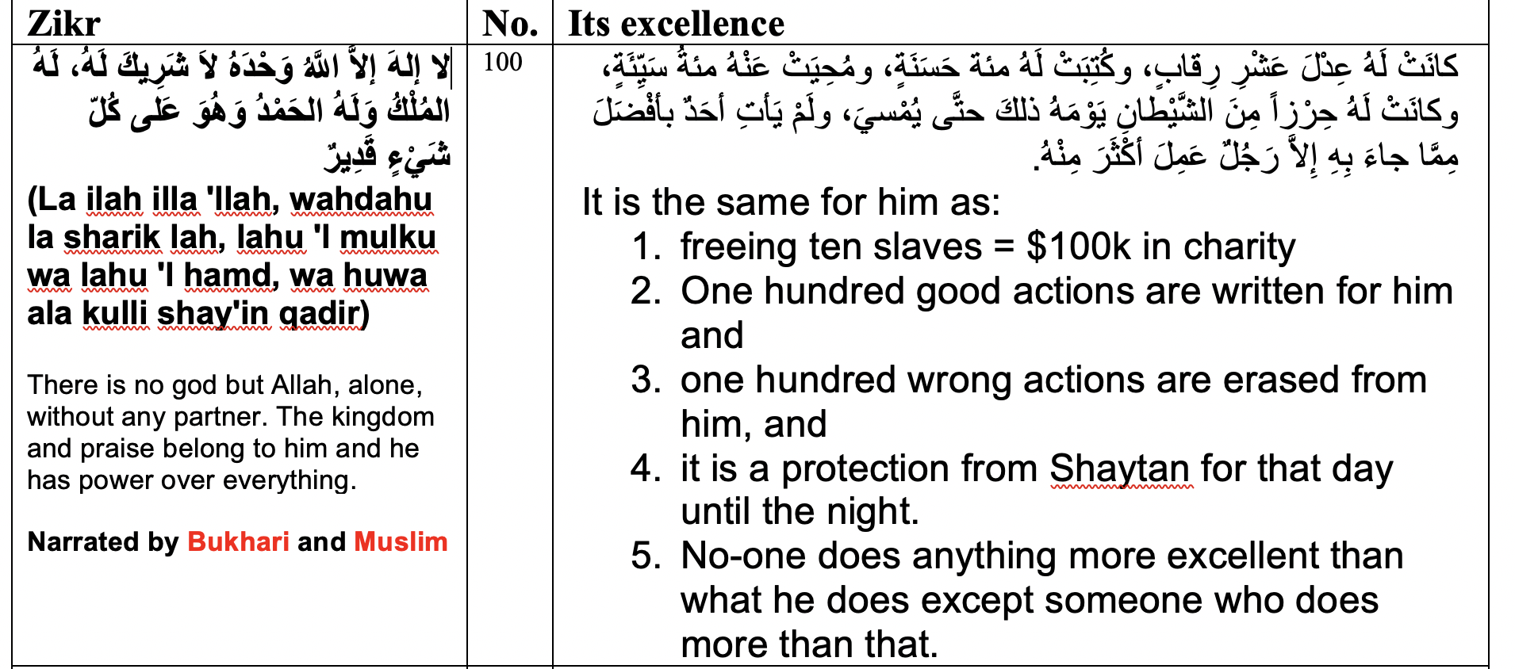
Zikr Link to this Khutbah at http://youtu.be/osCvLMoNmbA and https://ILoveAllah.net
https://iloveallah.net/static/Zikr_table2.pdf
- Until next session, isA

Slide 29
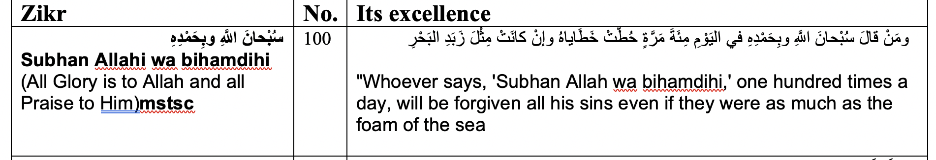
Zikr Link to this Khutbah at http://youtu.be/osCvLMoNmbA and https://ILoveAllah.net
https://iloveallah.net/static/Zikr_table2.pdf
- Until next session, isA

Slide 30
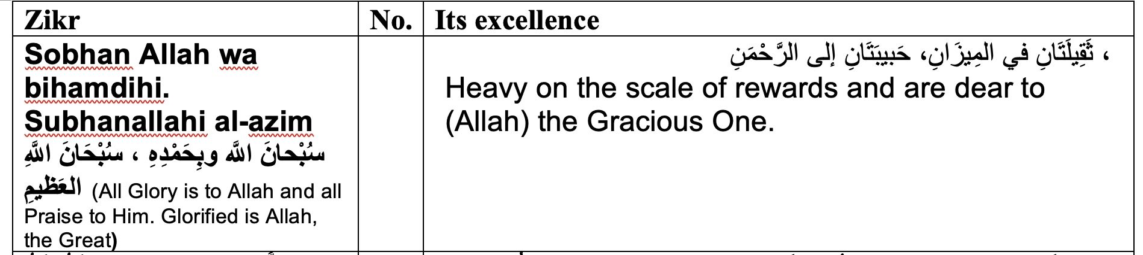
Zikr Link to this Khutbah at http://youtu.be/osCvLMoNmbA and https://ILoveAllah.net
https://iloveallah.net/static/Zikr_table2.pdf
- Until next session, isA

Slide 31
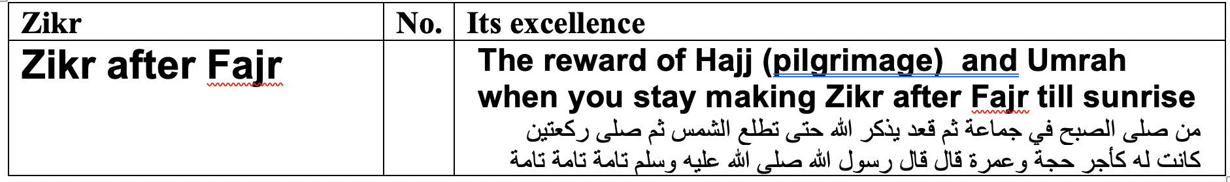
Zikr Link to this Khutbah at http://youtu.be/osCvLMoNmbA and https://ILoveAllah.net
https://iloveallah.net/static/Zikr_table2.pdf
- Until next session, isA

Slide 32
Advanced Plan

Slide 33
Imam Al-Bukhari narrated on the authority of ‘Ubaadah bin Assaamit (RAA) that the Messenger of Allah ASWS said:
من تَعَارَّ من الليلِ فقال : لا إلهَ إلَّا اللهُ وحدَهُ لا شريكَ لهُ ، لهُ المُلْكُ ولهُ الحمدُ ، وهوَ على كلِّ شيٍء قديرٌ ، الحمدُ للهِ ، وسبحانَ اللهِ ، ولا إلهَ إلَّا اللهُ ، واللهُ أكبرُ ، ولا حولَ ولا قوةَ إلا باللهِ ، ثم قال : اللهمَّ اغفرْ لي ، أو دعا ، استُجِيبَ لهُ ، فإن توضَّأَ وصلَّى قُبِلَتْ صلاتُهُ .
الراوي: عبادة بن الصامت المحدث: البخاري - المصدر: صحيح البخاري - الصفحة أو الرقم:1154
خلاصة حكم المحدث: [صحيح]
“Whoever happens to wake up (by alarm or became just partially conscious) in the night and says (He/she does not have to make Wudu or get up from bed):
Laa Ilaaha Illallaah, wahdahu la shareeka lah, lahul mulku walahulhamd, wa huwa ‘ala kulli shay’in qadeer. Al-hamdulillah, wa Subhanallah, walaa ilaaha illallaah, wallahu akbar, wa laa hawla wala quwwata illa billah,
Then asks for forgiveness, or make Du’a,
Allah will answer him.
Then if he performs Wudu’ and prays, Allah will accept his prayer.”
Ibn Hajar (ra) said: “No Muslim who heard of this Hadeeth should neglect it. He should teach it to his family and act upon it.”

Slide 34
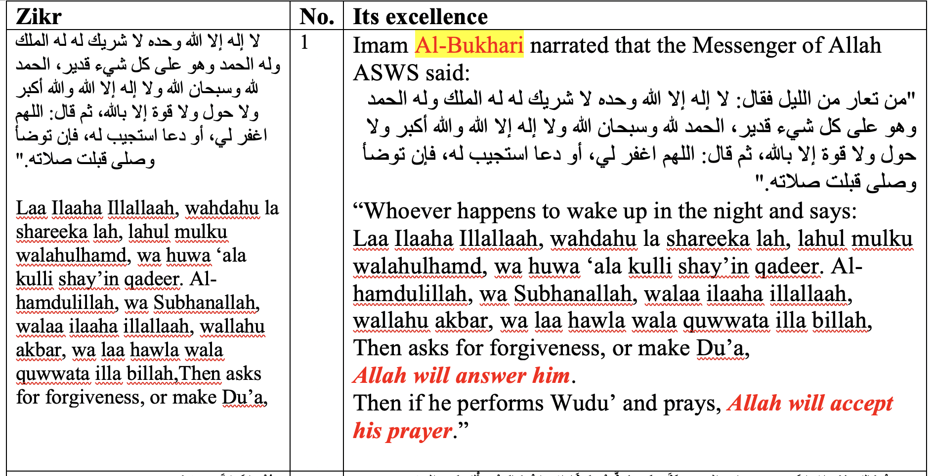
Zikr Link to this Khutbah at http://youtu.be/osCvLMoNmbA and https://ILoveAllah.net
https://iloveallah.net/static/Zikr_table2.pdf
- Until next session, isA

Slide 35
Advanced Plan
Take the last week of July off (most of the 10 days and Eid)
Fast the first 9 days
Put your alarm at 2:30AM
Say the previous Zikr while in bed and make duaa with your own language
Get up with intentions (Qiam, Hajah, Tawbah, Estikharah, Getting closer to Allah to love you …) and pray until Sohoor
Take sohoor and intention to fast
Pray Fajr in congregation (even with Family)
Stay until Shorooq doing Zikr, especially the 100 times to get protection from Shaytan

Slide 36
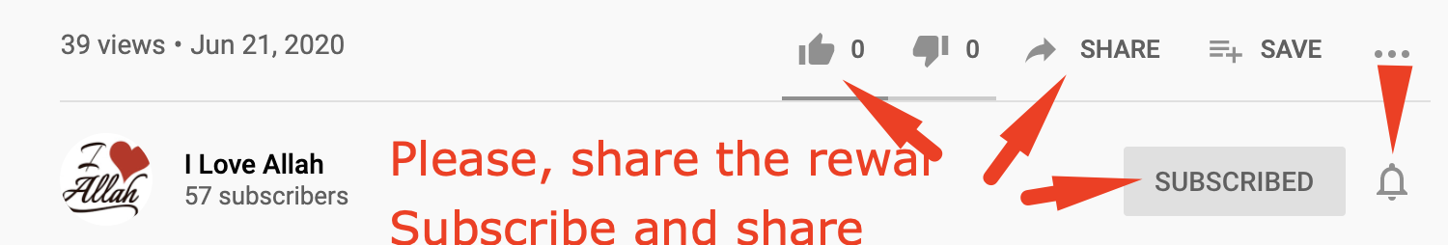
The Prophet (PBUH) said who ever share something good Will get the same reward as who started it and It will keep multiplying until day of judgment Please, share to multiply the Reward isA. When you subscribe, Like, and share you allow others to find it, isA
Website:
https://iloveallah.net
YouTube Channel:
https://www.youtube.com/channel/UCZDYWIWY1pMaGg4-iw3uz1w

Slide 37
Questions / Discussions

Slide 38
The Prophet (PBUH) said who ever share something good Will get the same reward as who started it and It will keep multiplying until day of judgment Please, share to multiply the Reward isA. When you subscribe, Like, and share you allow others to find it, isA
Website:
https://iloveallah.net
YouTube Channel:
https://www.youtube.com/channel/UCZDYWIWY1pMaGg4-iw3uz1w

