Slide 1


خطوات عملية للسعادة Practical Steps to happiness
Website:
https://iloveallah.net
YouTube Channel:
https://www.youtube.com/channel/UCZDYWIWY1pMaGg4-iw3uz1w
YouTube Playlist:
https://www.youtube.com/playlist?list=PLNT8BTFvQYHLWc7EkqE0OYo1sRCuQwYzv

Slide 2
Review and Follow-up

Slide 3
Happiness is in the heart/Spirit
Ibn al-Qayyim reported: Shaykh Ibn Taymiyyah, may Allah have mercy on him, said to me once, “In this life there is a paradise, who did not enter it, will not enter the paradise in the hereafter … what can my enemies do to me? My paradise and my garden are in my heart, they are with me wherever I go and they are never separated from me. If I am imprisoned, then it is seclusion for worship. If I am killed, then it is martyrdom. If they expel me from my land, then it is tourism.”
Source: al-Wābil al-Ṣayyib 1/48
عن ابن القيم قَالَ وَقَالَ لِي شَيْخَ الْإِسْلَامِ ابْنَ تَيْمِيَّةَ رحمه الله مَرَّةً إنّ في الدينا جنة من لم يدخلها لم يدخل جنة الآخرة ... مَا يَصْنَعُ أَعْدَائِي بِي أَنَا جَنَّتِي وَبُسْتَانِي فِي صَدْرِي أَيْنَ رُحْت فَهِيَ مَعِي لَا تُفَارِقُنِي أَنَا حَبْسِي خَلْوَةٌ وَقَتْلِي شَهَادَةٌ وَإِخْرَاجِي مِنْ بَلَدِي سِيَاحَةٌ
1/48 الوابل الصيب من الكلم الطيب

Slide 4
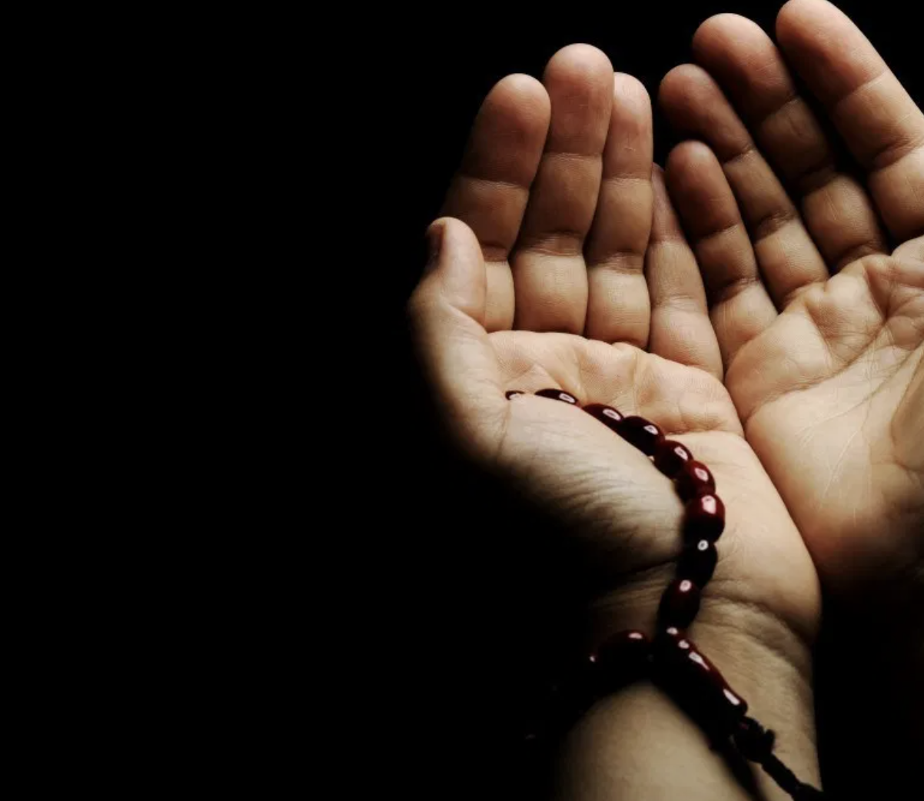
1. Ask Allah for help

Slide 5
Duaa (Supplication)
The most important medication

Slide 6
WISHES and PROBLEMS
Life is driven by 2 things:
Wishes we wish to have
Problems we wish to solve

Slide 7
WISHES
Who does not have wishes in this life:
Happy life
Better house
Be better at Work
More money
Health, wealth, kids, …

Slide 8
WISHES
Wishes for the hereafter:
Forgiveness
Paradise
Protection from the hellfire

Slide 9
Problems
Who does not have Problems:
At work
At Home
Sadness, Depression, Health, Financial, Relation
Stopping a sin (ex: lowering the gaze)
Waking up for Fajr

Slide 10

Imagination
The imagination of people led them to something that will fulfill their wishes.
A Fake Genie

Slide 11

Imagination
The imagination of people led them to something that will fulfill their wishes.
Or A Magic Wand

Slide 12
even their imaginations were limited. They could not imagine unlimited wishes fulfiller. They usually imagine a genie to give three wishes and the Max I have seen in the Egyptian movies were seven wishes.
What they did not know that we have a better from their fake genie. We have the
unlimited wishes.

Slide 13
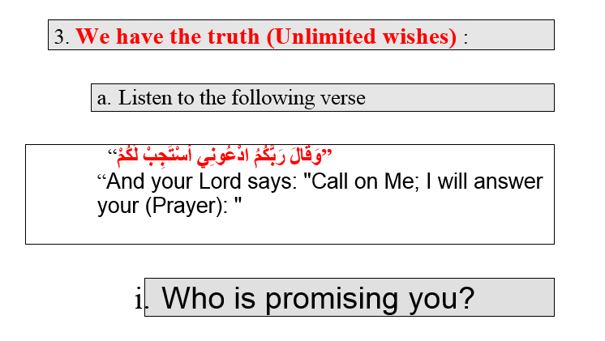

Slide 14
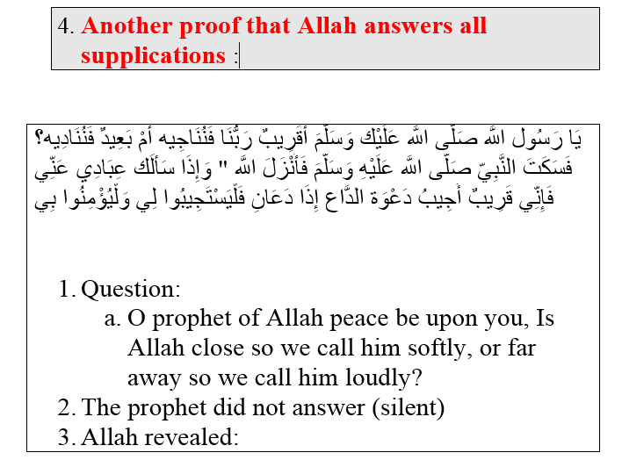


Slide 15
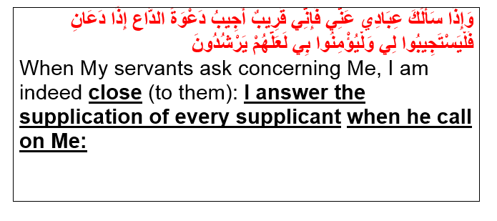

Slide 16
According to a hadith of the Prophet (SAW):
“There is no Muslim who calls upon his Lord with a duaa in which there is no sin or severing of family ties, but Allah will give him one of three things: Either He will answer his prayer quickly, or He will store (the reward for) it in the Hereafter, or He will divert an equivalent evil away from him.” They said: “We will say more duaa.” He said: “Allah’s bounty is greater.” [Narrated by Ahmad, 10749; Al-Tirmidhi, 3573. Classed as Saheeh by Al-Albaani in Mishkaat Al-Masaabeeh, 2199]
ما من مسلم يدعو الله بدعوة ليس فيها إثم ولا قطيعة رحم إلا أعطاه الله بها إحدى ثلاث: إما أن تعجل له دعوته، وإما أن يدخرها له في الآخرة، وإما أن يصرف عنه من السوء مثلها

Slide 17
إنَّ ربَّكم حَييٌّ كريمٌ يستَحي مِن عبدِهِ إذا رفعَ يدَيهِ إليهِ بدعوَةٍ أن يرُدَّهُما صِفرًا ليسَ فيهما شيءٌ
الراوي: سلمان الفارسي المحدث: الألباني - المصدر: مختصر العلو - الصفحة أو الرقم: 37
خلاصة حكم المحدث: صحيح
“Surely Allah is Hayyee, and He loves to conceal the shortcomings of His slaves. If His slave raises his hands, He does not let him go empty handed.”

Slide 18
لا يردُّ القضاءَ إلا الدعاءُ، و لا يزيدُ في العمرِ إلا البرُّ
الراوي: سلمان الفارسي المحدث: السيوطي - المصدر: الجامع الصغير - الصفحة أو الرقم: 9968
خلاصة حكم المحدث: صحيح
Nothing can divert what was written for you, except Duaa

Slide 19
Who is going to help us but Allah?
Have you ever seen a poor man asking another poor man for money?
According to the Hadith Kodosy:
Allah (s) said: You are all lost except those I guided. So ask me guidance and I will guide you.You are all naked except those I gave cloth.
If the whole world asked Allah (S) on the same time and he granted every one’s wish, this will not decrease Allah’s kingdom at all.

Slide 20
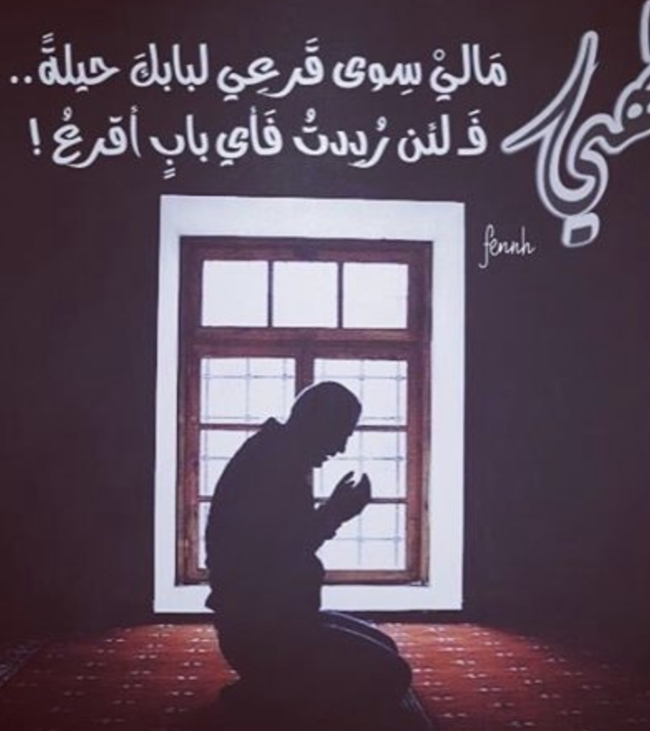
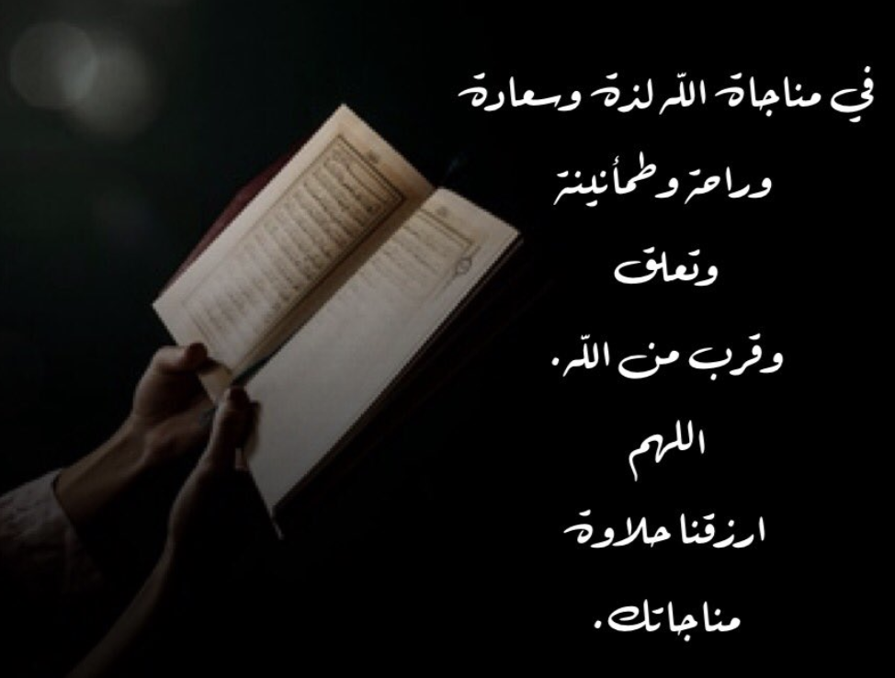
1-1. Monologue with Allah(free style duaa). مناجاة الله

Slide 21
1-1. Monologue with Allah(free style duaa). مناجاة الله
إِذْ قَالَتِ امْرَأَةُ عِمْرَانَ رَبِّ إِنِّي نَذَرْتُ لَكَ مَا فِي بَطْنِي مُحَرَّراً فَتَقَبَّلْ مِنِّي إِنَّكَ أَنتَ السَّمِيعُ الْعَلِيمُ
When a woman of Imran said: My Lord! surely, I vow to you what is in my womb, to be devoted (to your service); accept therefore from me, surely you are the most Hearing, the most Knowing.
فَلَمَّا وَضَعَتْهَا قَالَتْ رَبِّ إِنِّي وَضَعْتُهَا أُنثَى وَاللّهُ أَعْلَمُ بِمَا وَضَعَتْ وَلَيْسَ الذَّكَرُ كَالأُنثَى وَإِنِّي سَمَّيْتُهَا مَرْيَمَ وِإِنِّي أُعِيذُهَا بِكَ وَذُرِّيَّتَهَا مِنَ الشَّيْطَانِ الرَّجِيمِ
So when she brought forth, she said: My Lord! Surely I have brought it forth a female-- and Allah knew best what she brought forth-- and the male is not like the female, and I have named it Mariam, and I commend her and her offspring into your protection from the accursed Shaitan.

Slide 22
Monologue with Allah. مناجاة الله
A mention of the mercy of your Lord to His servant Zakariya.
When he called upon his Lord in a low voice,
He said: My Lord! surely my bones are weakened and my head flares with hoariness, and, my Lord! I have never been unsuccessful in my prayer to you
And surely I fear my cousins after me, and my wife is barren, therefore grant me from you a successor
"(One that) will (truly) represent me, and represent the posterity of Jacob; and make him, O my Lord! one with whom Thou art well-pleased!"
ذِكْرُ رَحْمَةِ رَبِّكَ عَبْدَهُ زَكَرِيَّا
إِذْ نَادَى رَبَّهُ نِدَاء خَفِيّاً
قَالَ رَبِّ إِنِّي وَهَنَ الْعَظْمُ مِنِّي وَاشْتَعَلَ الرَّأْسُ شَيْباً وَلَمْ أَكُن بِدُعَائِكَ رَبِّ شَقِيّاً
وَإِنِّي خِفْتُ الْمَوَالِيَ مِن وَرَائِي وَكَانَتِ امْرَأَتِي عَاقِراً فَهَبْ لِي مِن لَّدُنكَ وَلِيّاً
يَرِثُنِي وَيَرِثُ مِنْ آلِ يَعْقُوبَ وَاجْعَلْهُ رَبِّ رَضِيّاً

Slide 23
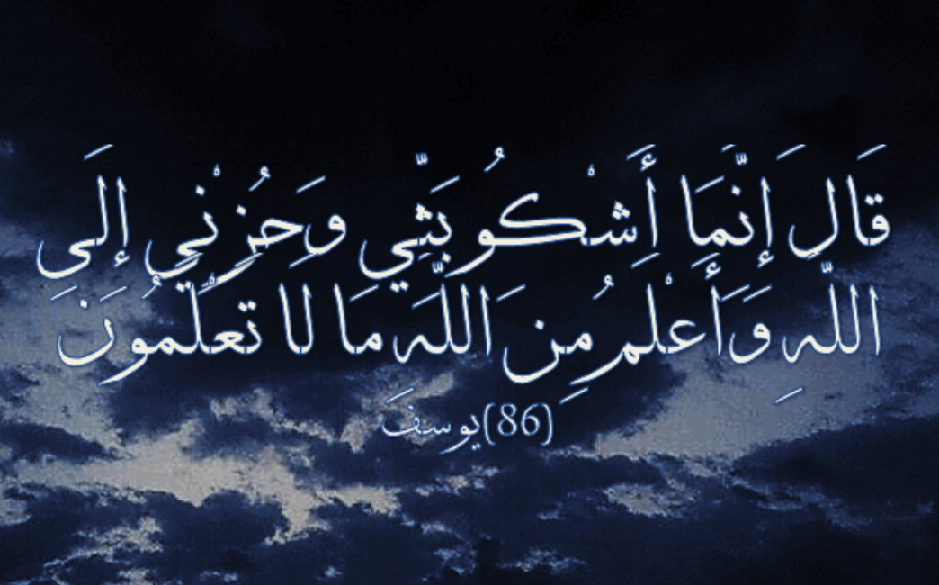
He answered: "It is only to God that I complain of my deep grief and my sorrow

Slide 24
Monologue with Allah. مناجاة الله
Oh, Allah, I appeal to you for the weakness in my strength, and my limited power, and the treatment of contempt and humiliation from people. To you, the most Merciful of all the Merciful ones, you are the Lord of the oppressed, and you are my Lord
Under whose care are you leaving me to? To an enemy oppressing me? Or to a friend you have given control of my affair? If there is no anger from you on me I will forever be content. However, your blessing is vastly important for me
I seek refuge with the glory of your light, which the heavens and earth are lit form, your anger will not befall on me, nor your displeasure descends on me
To you is the supplication until you are pleased, and there is no control or power except by you
للهم إليك أشكو ضعف قوتي، وقلة حيلتي، وهواني على الناس، يا أرحم الراحمين، إلى من تكلني، إلى عدو يتجهمني، أو إلى قريب ملكته أمري، إن لم يكن بك علي غضب فلا أبالي، غير أن عافيتك أوسع لي، أعوذ بنور وجهك الذي أشرقت له الظلمات، وصلح عليه أمر الدنيا والآخرة، أن تنزل بي غضبك، أو يحل علي سخطك، لك العتبى حتى ترضى، ولا حول ولا قوة إلا بك.

Slide 25
تعتبر مناجاة الله والتوجه إليه من أكثر الأمور التي يجب أن يحرص عليها الإنسان المسلم، لا سيّما في جوف الليل؛ فهي تُقرّب العبد من ربه وتجعله يستجيب لمناجاته وما يرغب، وتكون المناجاة مخاطبةً لله سراً، أو دعاء بين الإنسان ونفسه بحيث يطلب من الله حاجته بقلبٍ طاهرٍ وسليم، وبإخلاصٍ وخشوعٍ تام. فيما يلي نذكر مجموعةً من الكلمات التي يُمكن أن يناجي فيها العبد الله سبحانه وتعالى.
The Monologues of God and asking God are among the most important things that a Muslim should take care of, especially in the end of night. It brings the servant closer to his Lord and makes him respond to his encounters and what he desires, and the Monagah (Monologue) is addressed to God in secret, or supplication between man and himself, so that he asks God for his need with a pure and healthy heart, with sincerity and complete reverence. Below we mention a group of words in which the servant of God Almighty may call.

Slide 26
Examples in English

Slide 27
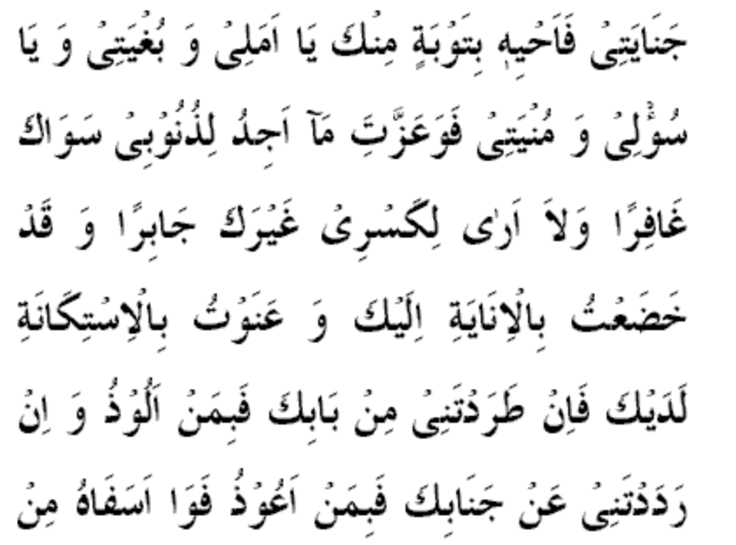
Start With praising Allah | O my wish and my want! By your might, I find no one but you to forgive my sins and I see none but you to mend my brokenness! I have subjected myself to you in repeated turning, I have humbled myself to you in abasement. If you cast me out from your door, in whom shall I take shelter? If you expel me from your side, in whom shall I seek refuge? O my grief at my ignominy and disgrace! O my sorrow at my evil works and what I have committed!
Repent | My dreadful crimes have killed my heart, so bring it to life by a repentance from you! O my hope and my aim! O my wish and my want! My God does the runaway servant go back but to his master or does anyone grant sanctuary to him from HIS anger but HE
Free Style Complain, or Ask | O Allah, I Love You and I ask you to fill my heart with your love, the love of all deeds that get me closer to your love, and the love of those who love you. O Allah, I appeal to you from the hardness of my heart. O Allah, you are the owner of the hearts, I ask you to soften my heart.

Slide 28
Free Style Complain, or Ask | O Allah, today I committed this sin in ignorance. I did not do it to challenge your commands but I was overpowered by my desire and devil. O Allah, I ask your forgiveness…

Slide 29
Free Style Complain, or Ask | O Allah, today Mike oppressed me, and I have no one to go to except you. O Allah, I refuge to you and ask you to protect me from his evil and return my right. If you cast me out from your door, in whom shall I take shelter? If you expel me from your side, in whom shall I seek refuge?

Slide 30
How to get all your duaa to be accepted all the time
A High stage ولي الله

Slide 31
Bukhari Narrated:
إن الله قال : من عادى لي وليا فقد آذنته بالحرب ،
"Allah said, 'I will declare war against him who shows hostility to a pious worshipper of Mine.
وما تقرب إلي عبدي بشيء أحب إلي مما افترضت عليه ،
And the most beloved things with which My slave comes nearer to Me, is what I have enjoined upon him; (The obligations)
5 Prayers on time daily (Preferably in the mosque)
Fast Ramadan
Zakat
Lowering the gazes
Take care of your family and parents

Slide 32
وما يزال عبدي يتقرب إلي بالنوافل حتى أحبه ،
and My slave keeps on coming closer to Me through performing Nawafil (praying or doing extra deeds besides what is obligatory) till I love him,
Duaa
Pray:
12 raka3ah sonnah (2, 6, 2, 2)
Extras are (2 before Zuhur, 4 before Asr, 2 before Maghrib, 2 before Ishaa, Kiam (8 or 20), Wetr 3)
Fast:
Mondays and Thursdays
13, 14, and 15 of each month
Arafah, 3ashoraa…
Charity
Quran
Follow Sonnan
Sleep on Wodou
Swak

Slide 33
فإذا أحببته : كنت سمعه الذي يسمع به ، وبصره الذي يبصر به ، ويده التي يبطش بها ، ورجله التي يمشي بها ، وإن سألني لأعطينه ، ولئن استعاذني لأعيذنه ،
so I become his sense of hearing with which he hears, and his sense of sight with which he sees, and his hand with which he grips, and his leg with which he walks; and if he asks Me, I will give him, and if he asks My protection (Refuge), I will protect him; (i.e. give him My Refuge) [Bukhari]
قال شيخ الإسلام ابن تيمية عن هذا الحديث : " هو أشرف حديث روي في صفة الأولياء "

Slide 34
أَلا إِنَّ أَوْلِيَاء اللّهِ لاَ خَوْفٌ عَلَيْهِمْ وَلاَ هُمْ يَحْزَنُونَ
Oh, verily, they who are close to God - no fear need they have, and neither shall they grieve
Yunus (Jonah) 10:62

Slide 35
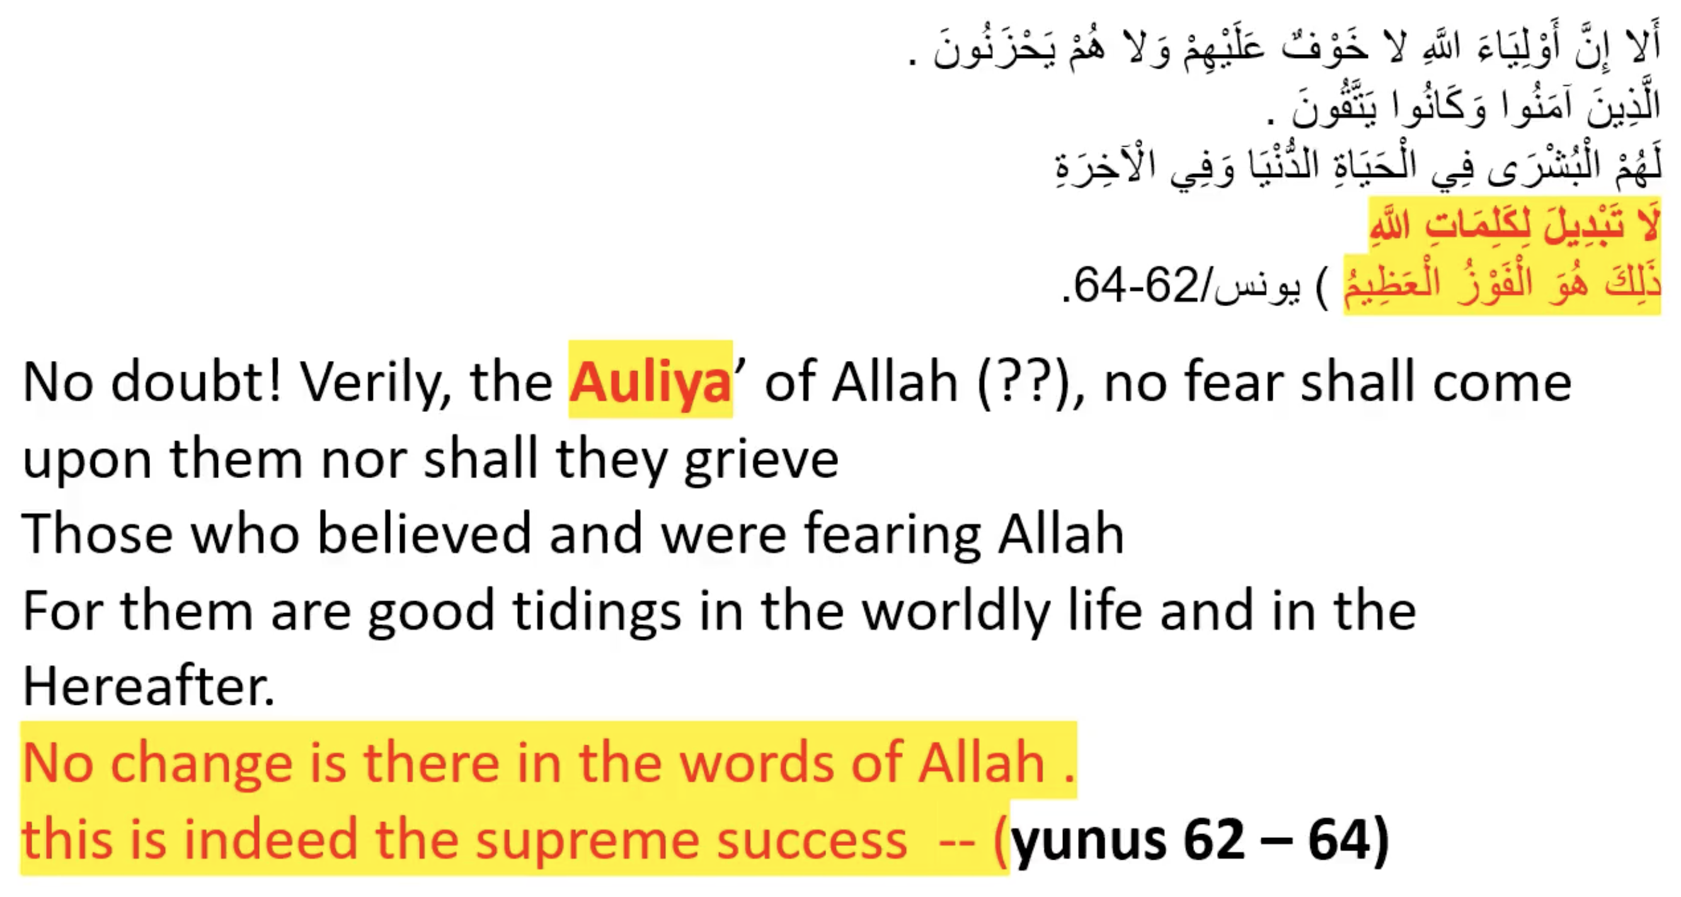

Slide 36
The state of Walyee ولي
This is the state of happiness that we will work to get to, through this series isA
It is a high state, if you reach this state you will have the happiness in your heart, protection from Allah, and all your requests will be fulfilled
It will take time to get your heart to this state and this will be our goal isA
Duaa of the Prophet (PBUH):
((اللَّهُمَّ اهْدِنِي فِيمَنْ هَدَيْتَ، وَعَافِنِي فِيمَنْ عَافَيْتَ، وَتَوَلَّنِي فِيمَنْ تَوَلَّيْتَ
'O Allah guide me among those You have guided, pardon me among those You have pardoned, befriend(make me Walyee) me among those You have befriended (Made Walyee)

Slide 37
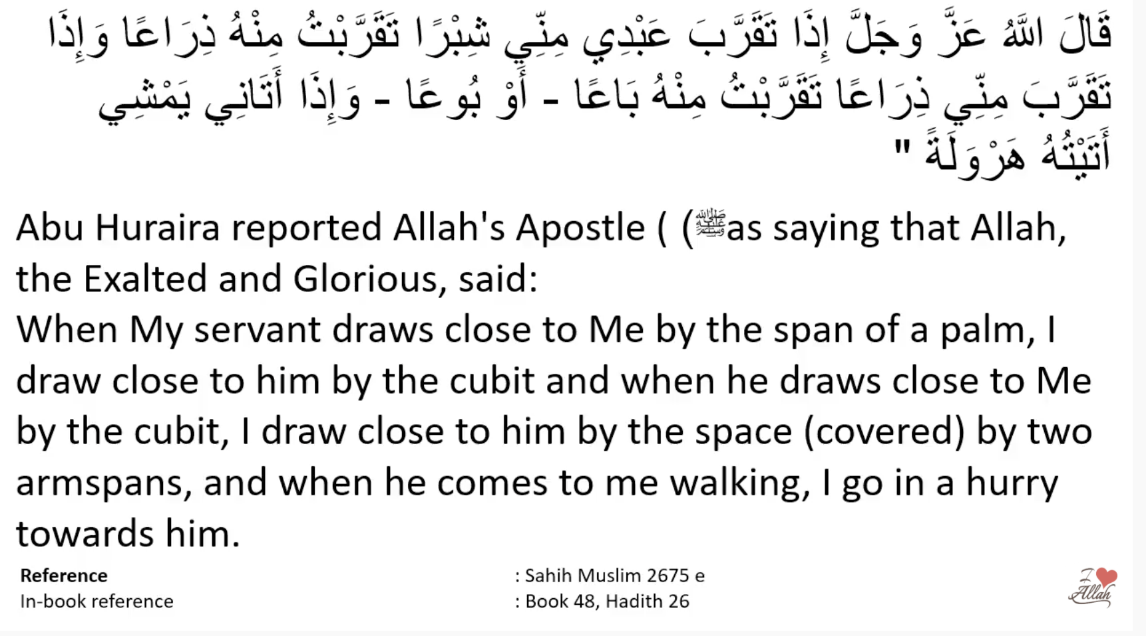

Slide 38
Best Times of Duaa

Slide 39
There many times of acceptance I will mention 3 of them, for this week
On Friday, before Maghrib
After each obligatory Prayer
Arafah يوم عرفه

Slide 40
Plan for this week
Until next time isA
https://iloveallah.net/happiness/

Slide 41
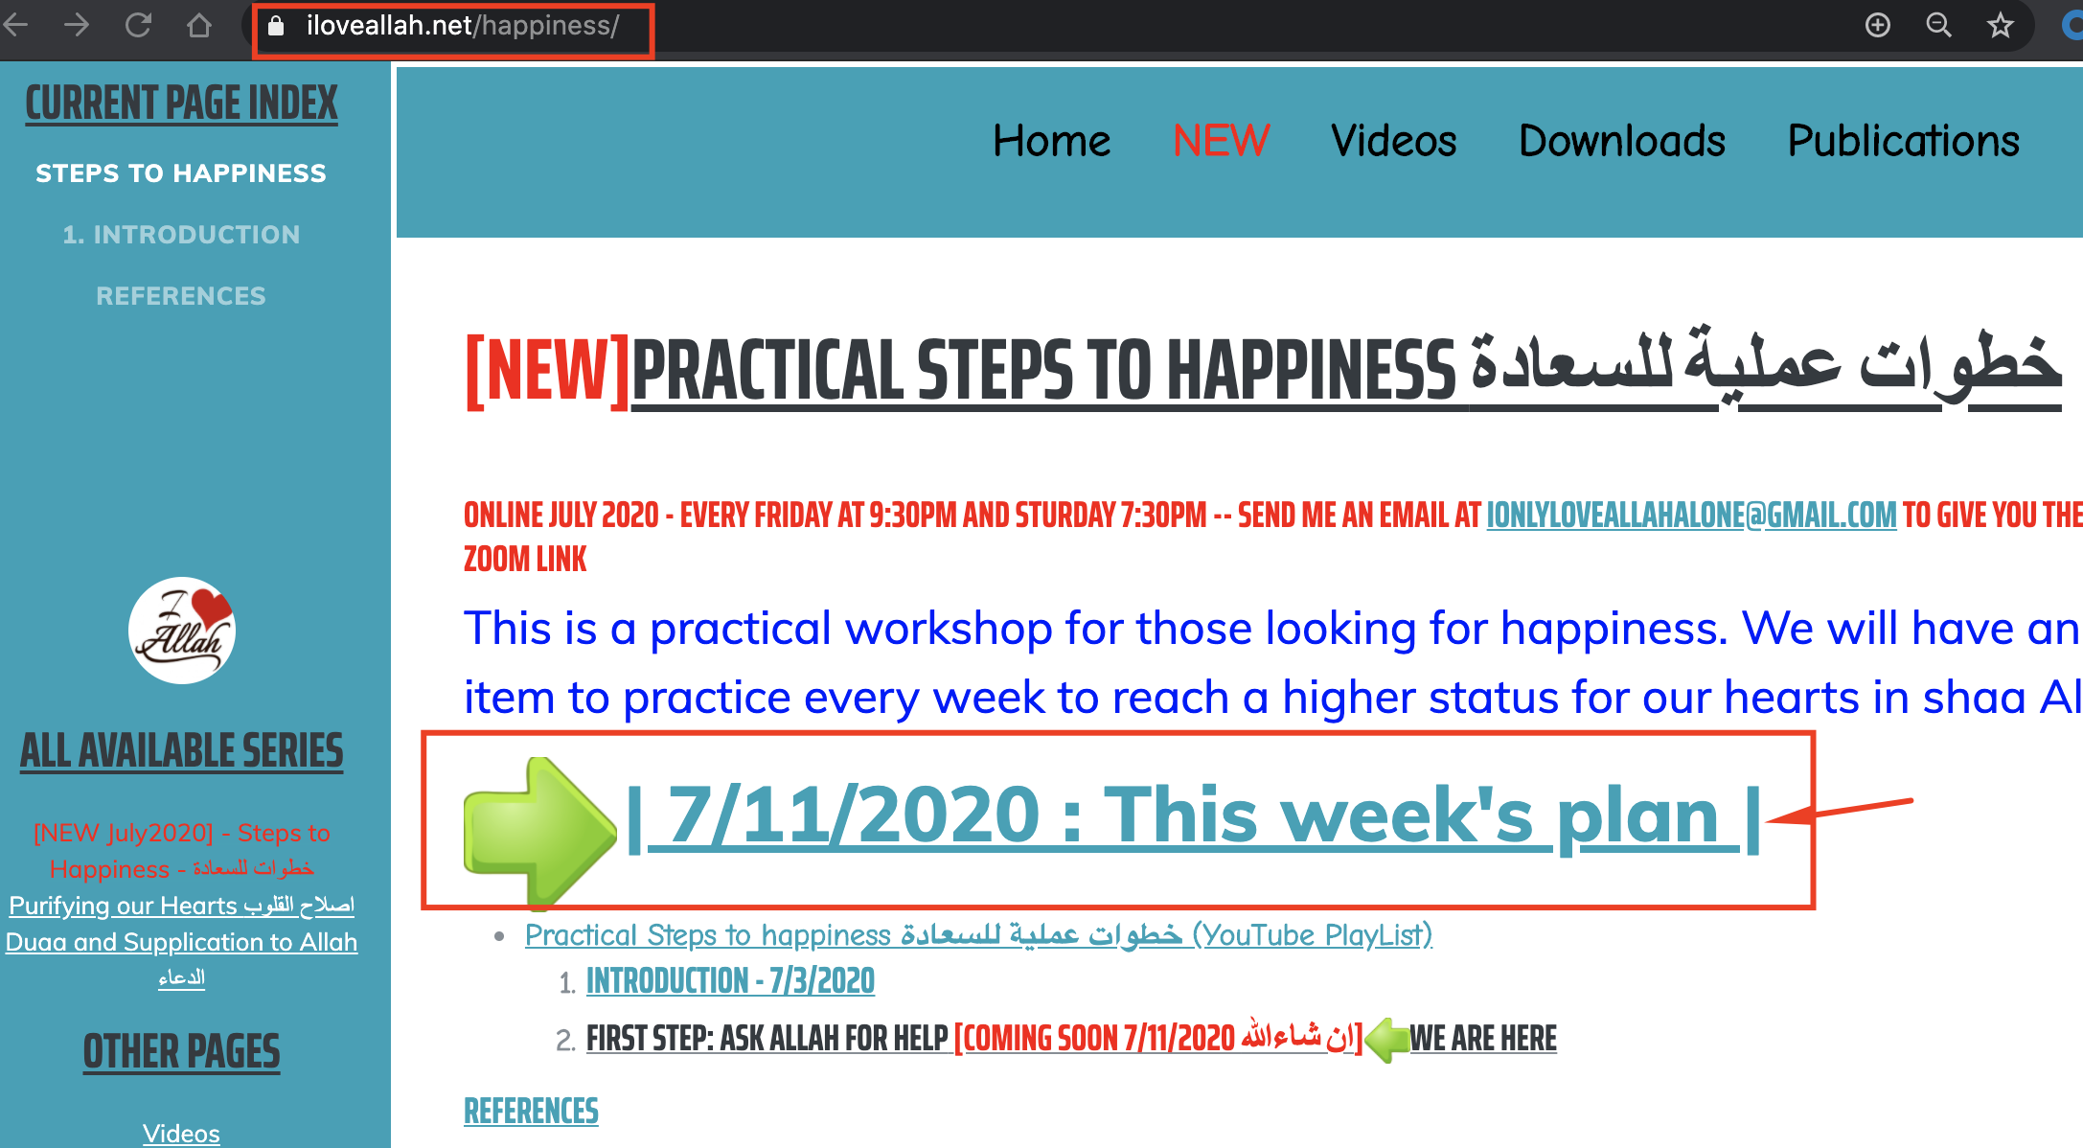
Plan for this Week
https://ILoveAllah.net/happiness - Until next session, isA

Slide 42
1. Focus on One Duaa to be Walyee
This is our goal is to become Walye and have a happy life and a happy hereafter
Ask Allah in your language, at least, after each prayer and on Friday before Maghrib [Better all the time]
Example in English:
O Allah, make me your Walyee. Make me from your Awlyaa, those who do not grieve or fear nothing but you. Those whom you love, and they love you.
Example in Arabic:
اللهم اجعلنا من اوليائك الذين لاخوف عليهم ولاهم يحزنون - من اوليائك الذين تحبهم ويحبونك – اللهم تولني فيمن توليت – اللهم اني اعلم اني لا استحق ولست كاوليائك ولكني اطمع في كرمك ياكريم اكرمني ومن علي بولايتك

Slide 43
2. Add a Sunnah every week:
وما يزال عبدي يتقرب إلي بالنوافل حتى أحبه ،
and My slave keeps on coming closer to Me through performing Nawafil (praying or doing extra deeds besides what is obligatory) till I love him,
Let’s add a sunnah every week to get closer to Allah to gain the Walyee
This week let’s focus on Duaa and Monologue, which is the best sunah that Allah loves
Our Goal to become a Walyee, let’s make Duaa all the times to become a Walyee

Slide 44
2. Add a Sunnah every week [Monajah/Monologue]:
Select any time that you will be alone (you do not have to have wodoo, face qibla, setting, … just on any state you are, even if it is when you just woke up and still on bed)
Talk to Allah with your language and complain, ask, or just talk (similar to the examples we gave before)
Until next week, isA, let’s aim for at least once a day
If you face a difficulty, start by complaining to Allah in free style and in your language and ask for help
If you grieve or feel sadness in your heart, monologue with Allah, immediately, even in secret
Try to make Monajah(Monologue) 15 minutes before Maghrib on Friday.

Slide 45
ليس شيء أكرم على الله تعالى من الدعاء
الراوي: أبو هريرة المحدث: السيوطي - المصدر: الجامع الصغير - الصفحة أو الرقم: 7602
خلاصة حكم المحدث: صحيح
There is nothing more generous to Allah than the supplications (Duaa)

Slide 46
عن النَّبيِّ صلَّى اللهُ عليه وسلَّمَ في قولِه : وَقَالَ رَبُّكُمُ ادْعُونِي أَسْتَجِبْ لَكُمْ وقال : الدعاءُ هو العبادةُ وقرأ وَقَالَ رَبُّكُمُ ادْعُونِي أَسْتَجِبْ لَكُمْ إلى قولِه دَاخِرِينَ
الراوي: النعمان بن بشير المحدث: الترمذي - المصدر: سنن الترمذي - الصفحة أو الرقم: 2969
خلاصة حكم المحدث: حسن صحيح

Slide 48
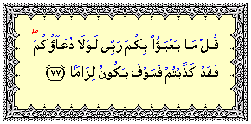
1.
بل حذر سبحانه عباده من نسيان الدعاء، وترك التضرع، والإعراض عن الالتجاء الى الله، فقال: قُلْ مَا يَعْبَأُ بِكُمْ رَبِّي لَوْلَا دُعَاؤُكُمْ فَقَدْ كَذَّبْتُمْ فَسَوْفَ يَكُونُ لِزَاماً (77) الفرقان.
Allah (s) cares about us because of our Doaa
77] Say (to the Rejecters): "My Lord is not uneasy because of you if ye call not on Him: but ye have indeed rejected (Him), and soon will come the inevitable (punishment)!"

Slide 49
وقال : { إنه من لم يسأل الله تعالى يغضب عليه }.
Whoever does not ask Allah, Allah will be angry at him
وقال : { أعجز الناس من عجز عن الدعاء، وأبخل الناس من بخل بالسلام }.
The most disabled people are those who can’t make duaa

Slide 50
- أفضل العبادة الدعاء الراوي: عبدالله بن عباس و أبو الدرداء و أبو هريرة - خلاصة الدرجة: صحيح - المحدث: الألباني - المصدر: صحيح الجامع - الصفحة أو الرقم: 1122 The best of the worship is the Doaa.

Slide 51
Discussion

Slide 52
Reference
https://youtu.be/8LwXP7HrZlg

Slide 53
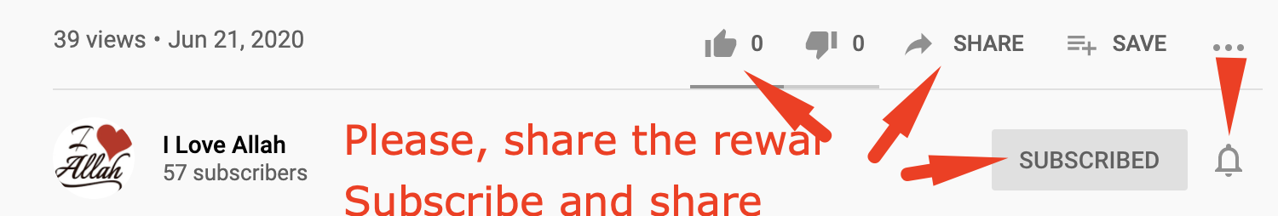
The Prophet (PBUH) said who ever share something good Will get the same reward as who started it and It will keep multiplying until day of judgment Please, share to multiply the Reward isA. When you subscribe, Like, and share you allow others to find it, isA
Website:
https://iloveallah.net
YouTube Channel:
https://www.youtube.com/channel/UCZDYWIWY1pMaGg4-iw3uz1w

Slide 54
The Prophet (PBUH) said who ever share something good Will get the same reward as who started it and It will keep multiplying until day of judgment Please, share to multiply the Reward isA. When you subscribe, Like, and share you allow others to find it, isA
Website:
https://iloveallah.net
YouTube Channel:
https://www.youtube.com/channel/UCZDYWIWY1pMaGg4-iw3uz1w

