Slide 1
Practicing Madarej Assalekeen 1. Consciousness of Sins 2. Consciousness of bounties of Allah 3. Conscious of time

Slide 2
1. Conscious of Sins
To be conscious of Sins and their dangerous , to Purify from it, and to get back on track

Slide 3
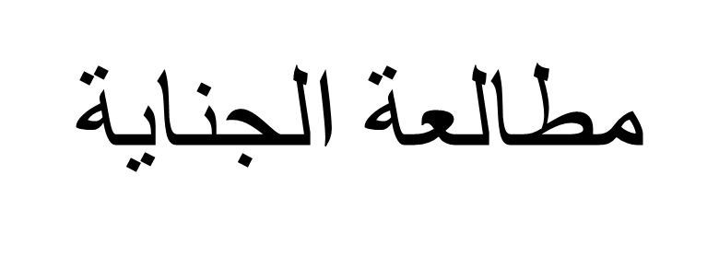
conscious of Sins
You have to be careful from committing any sin
Sins are easy, today. Internet, tv, street, ….
Ghaibah … back biting
The most dangerous thing isnto make sins and forget

Slide 4
consciousness of Sins
Stage of self- evaluation

Slide 5
O you who have believed, fear Allah . And let every soul look to what it has put forth for tomorrow – and fear Allah . Indeed, Allah is Acquainted with what you do.

Slide 6
Examine yourself, today, before you get examined. Weight your deeds, today, before it is weighed. It is easier today to examine yourself and prepare for the presentation day.
ALLAH SAYS:
“That Day, you will be exhibited [for judgment]; not hidden among you is anything concealed. “

Slide 7
​The first time you see your deeds when you receive your book
​don't make it the first time and read your sins now
​Imagine that tough day
1. People receive books with left hand
2. Behind their back
3. People are screaming and crying
4. People are dragged to hellfire
50000 angel taking him to hellfire

Slide 8
and others receive their book with right hand
happy and jumping
​and you are waiting
Which hand will you receive your book
To get the picture closer, imagine waiting for exam results

Slide 9
And the Book (of Deeds) will be placed (before you); and thou wilt see the sinful in great terror because of what is (recorded) therein; they will say, "Ah! woe to us! what a Book is this! It leaves out nothing small or great, but takes account thereof!" They will find all that they did, placed before them: And not one will thy Lord treat with injustice.
al-Kahf (The Cave) 18:49

Slide 10
And [for] every person We have imposed his fate upon his neck, and We will produce for him on the Day of Resurrection a record (in a book) which he will encounter spread open.
al-Isra' 017:013

Slide 11
[It will be said], "Read your record. Sufficient is yourself against you this Day as accountant."
al-Isra' 017:014

Slide 12
Whoever is guided is only guided for [the benefit of] his soul. And whoever errs only errs against it. And no bearer of burdens will bear the burden of another. And never would We punish until We sent a messenger.
al-Isra' 017:015

Slide 13
The Day We will call forth every people with their record [of deeds]. Then whoever is given his record in his right hand - those will read their records, and injustice will not be done to them, [even] as much as a thread [inside the date seed].
al-Isra' 017:071

Slide 14
al-Isra' 017:072
And whoever is blind in this [life] (blind from his book) will be blind in the Hereafter and more astray in way.

Slide 15
And you will see every nation kneeling [from fear]. Every nation will be called to its book of records [and told], "Today you will be recompensed for what you used to do.
This, Our record, speaks about you in truth. Indeed, We were having transcribed whatever you used to do."
al-Jathiyah 045:028-29

Slide 16
Imagine the stand in front of Allah to ask about each sin
Remind you with his bounties
What did you do with them?
Open the book and read the sins you have done with those bounties
Eyes and sight

Slide 17
That Day shall ye be brought to Judgment: not an act of yours that ye hide will be hidden.

Slide 18
Coming out of graves and carry your sins
Driver and witness
Carrying them for 50,000 years

Slide 19
قَدْ خَسِرَ الَّذِينَ كَذَّبُوا بِلِقَاءِ اللَّهِ ۖ حَتَّىٰ إِذَا جَاءَتْهُمُ السَّاعَةُ بَغْتَةً قَالُوا يَا حَسْرَتَنَا عَلَىٰ مَا فَرَّطْنَا فِيهَا وَهُمْ يَحْمِلُونَ أَوْزَارَهُمْ عَلَىٰ ظُهُورِهِمْ ۚ أَلَا سَاءَ مَا يَزِرُونَ
Those will have lost who deny the meeting with Allah , until when the Hour [of resurrection] comes upon them unexpectedly, they will say, "Oh, [how great is] our regret over what we neglected concerning it," while they bear their burdens on their backs. Unquestionably, evil is that which they bear.

Slide 20
Standing in front of the scale
“The A huge fat man will be brought on the Day of Resurrection, and he will not weigh before Allah even more than the wing of a gnat.” [Agreed upon] Muslim and Bukhari

Slide 21
( الطهور شطر الإيمان ، والحمد لله تملأ الميزان ، وسبحان الله والحمد لله تملآن – تملأ – ما بين السماوات والأرض ، والصلاة نور ، والصدقة برهان ، والصبر ضياء ، والقرآن حجة لك أو عليك ، كل الناس يغدو ، فبائع نفسه ، فمعتقها أو موبقها ) رواه مسلم
“Purity is half of faith and the praise of Allah fills the scale; glorification and praise fill up what is between the heavens and the earth. Prayer is a light, charity is proof (of sincere faith), and patience is illumination. The Quran is a proof for you or against you; all people go out early in the morning and sell themselves, either setting themselves free or destroying themselves.” Muslim

Slide 22
Abu Hurairah (May Allah be pleased with him) reported:
The Messenger of Allah (ﷺ) said, "There are two statements that are light for the tongue to remember, heavy in the Scales and are dear to the Merciful: 'Subhan-Allahi wa bihamdihi, Subhan-Allahil-Azim [Glory be to Allah and His is the praise, (and) Allah, the Greatest is free from imperfection]'." [Al-Bukhari and Muslim].
وعن أبي هريرة رضي الله عنه قال‏:‏ قال رسول الله صلى الله عليه وسلم‏:‏ ‏ "‏كلمتان خفيفتان على اللسان، ثقيلتان في الميزان، حبيبتان إلى الرحمن‏:‏ سبحان الله وبحمده، سبحان الله العظيم‏"‏ ‏(‏‏(‏متفق عليه‏)‏‏)‏‏.‏

Slide 23
How if you ignored the self-evaluation
Sins will keep accumulating until they become heavy
Example of Credit cards
Smoking
You will forget them [Allah enumerated them, and you forgot]:
Miss deleting them by repentance
Be surprised in the day of judgment with sins you forgot
Carry them for 50,000 years and will be asked for each sin

Slide 24
First confrontation with your Self
You are dealing with tough enemies
Satan
Your Ego [Nafs]
They will do their best to avoid the Mohasabah and bring their weapons to block you
Bedaa
Wife
…

Slide 25
Self critical
Admit your mistakes
Learn from them
And improve
Skills at work and interviews

Slide 26
How?
First time, set for 10 minutes and write down what you can think of Sins, with the following order:
Obligatory:
Prayers
Zakah
Fasting of Ramadan
Hajj
Sins (from major to less)
Adultery
Lowering the gaze
Praying at the mosque
Writes of people
…..

Slide 27
Examples
Khoshoo
Lowering the gaze at work, street, club
TV
Ryaa
Wasting time
Ghaibah
Stealing from work time
Missing Jamaa
Fajr
Qiam
Zikr after Fajr and Asr
Smoking
Touching women
Mixing with women
Mixing with Alcohol and music
Listen to music
No reading the Quran

Slide 28
Tools
Try to use your phone, since it will be all the time
OneNote
ColorNotes
….

Slide 29
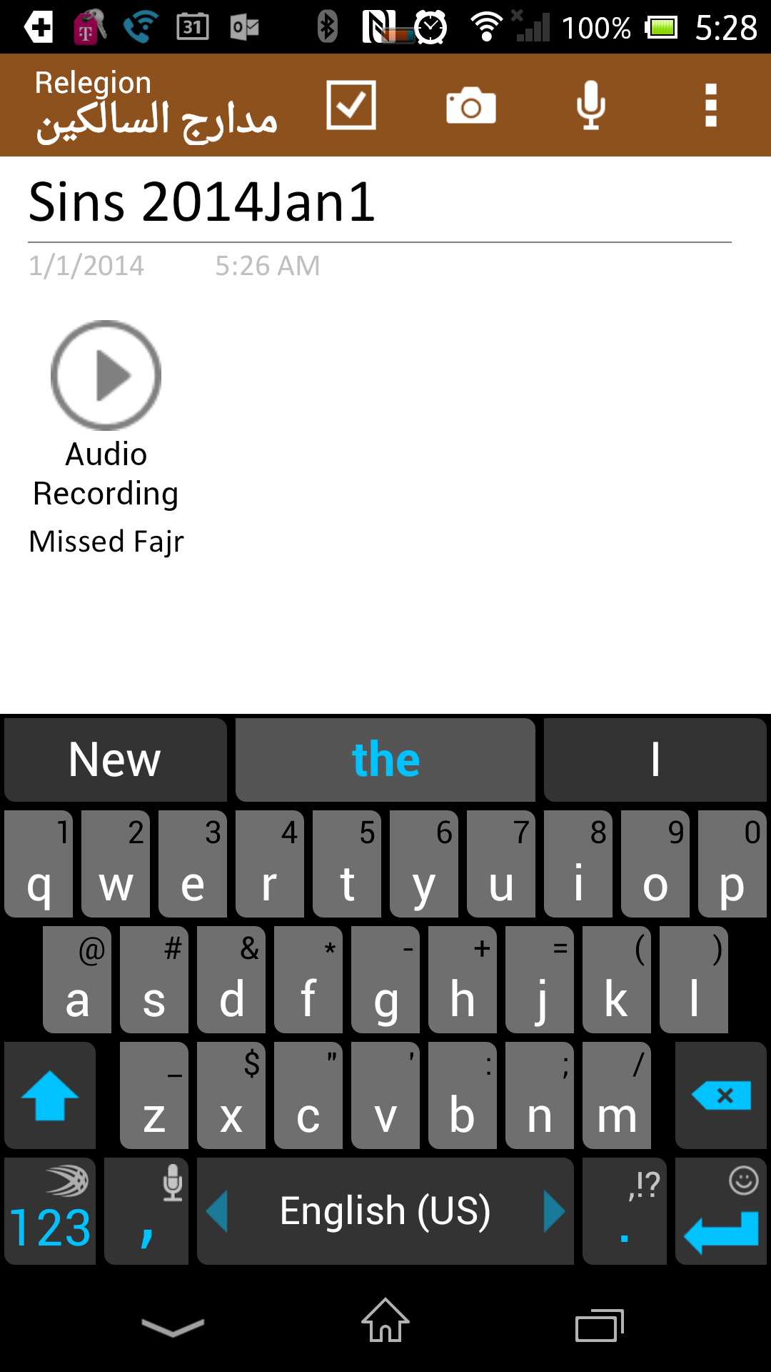
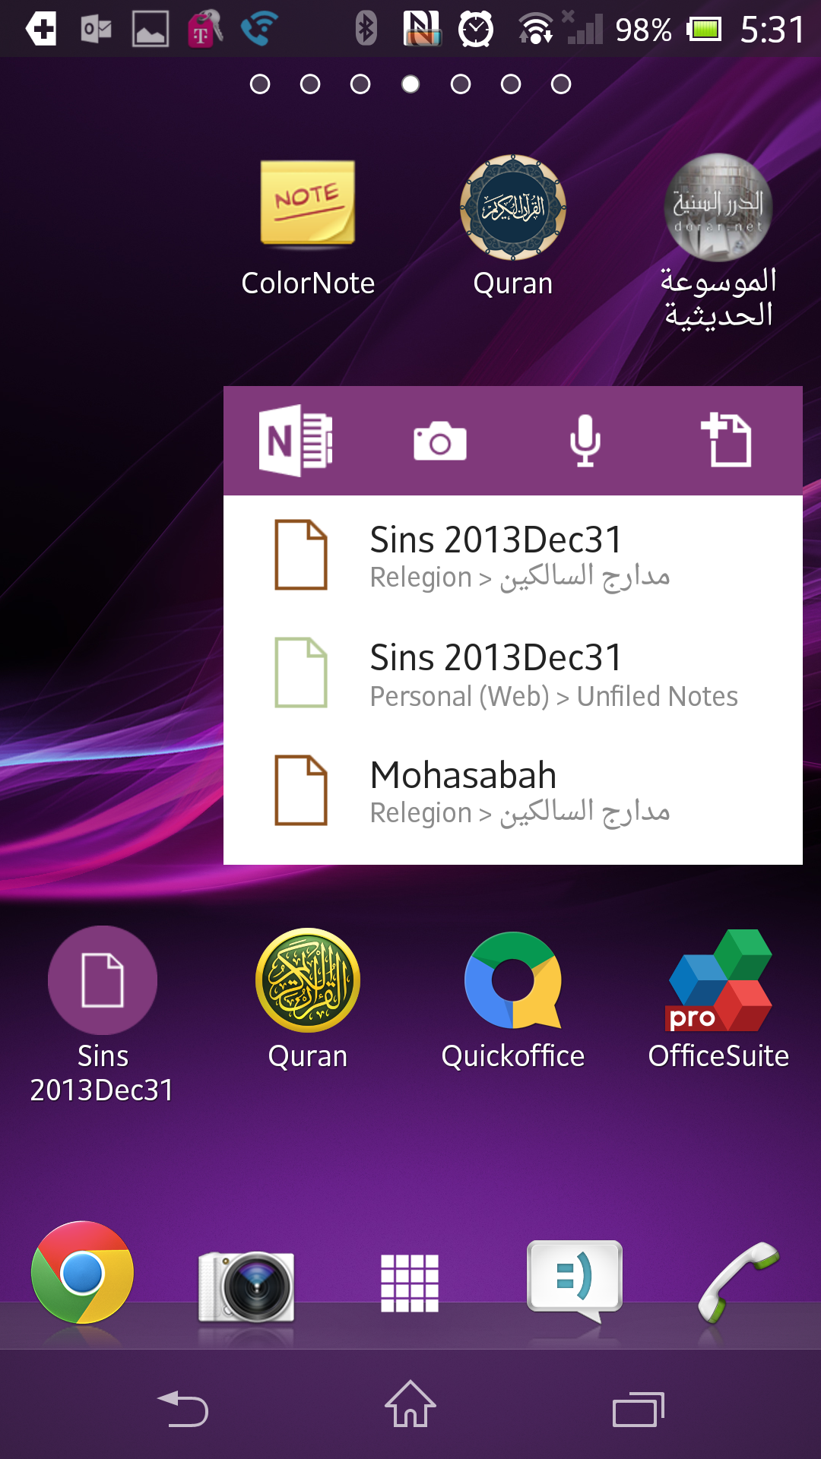

Slide 30
You should have 2 lists
Master list of shortcomings that are persistent and keep happening
Daily lists that contribute to the list above

Slide 31
Daily
Every time you commit a sin, write it immediately
Every time you think of a sin and can’t make it, write it
Keep writing and do not feel ashamed from people to see it and not from Allah
If you are worried that people will see it and you will feel ashamed, repent from it and do it, again, instead of writing it. If you came back to it, again, after tawbah, write down the cause of it (Such as: Gym, Swimming, Beach ….). And make tawbah from such thing (refer to the session of Tawbah)

