Slide 1
The Prophet (PBUH) said who ever share something good Will get the same reward as who started it and It will keep multiplying until day of judgment Please, share to multiply the Reward isA. When you subscribe, Like, and share you allow others to find it, isA
Website:
https://iloveallah.net and https://Myislam.net
YouTube Channel:
https://www.youtube.com/channel/UCZDYWIWY1pMaGg4-iw3uz1w

Slide 2
The Road to Allah مدارج السالكين
Websites:
https://MyIslam.net
https://iloveallah.net
YouTube Channel:
https://www.youtube.com/channel/UCZDYWIWY1pMaGg4-iw3uz1w
YouTube Playlist:
https://www.youtube.com/playlist?list=PLNT8BTFvQYHJ9RBJR54wk1j_O4DaQt-Zq

Slide 3
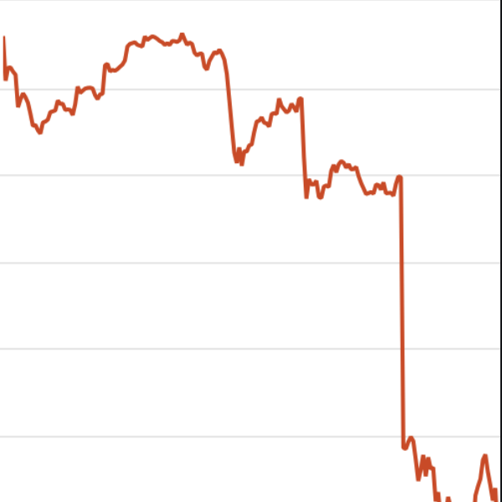
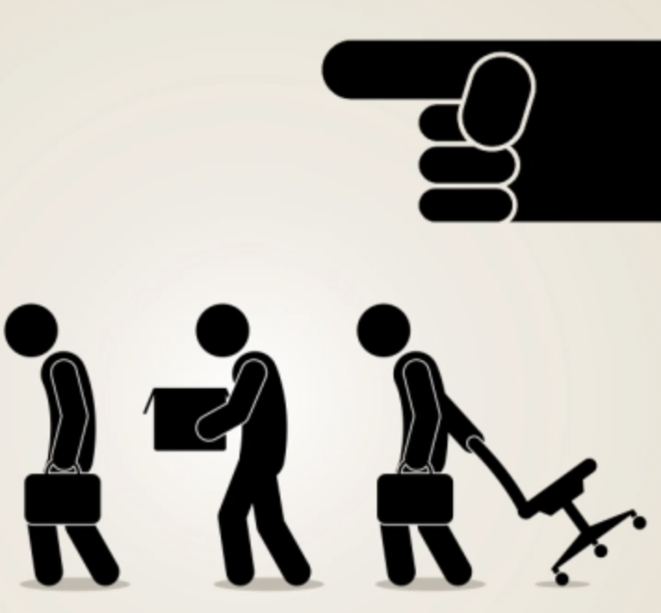
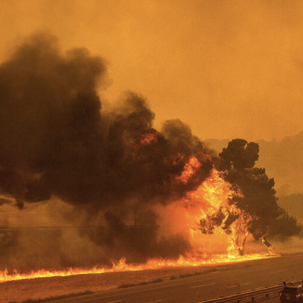

Slide 4
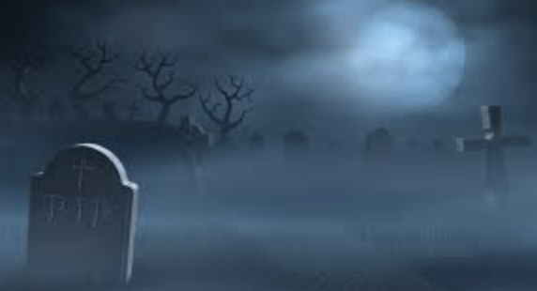

Slide 5
وَجَاءَتْ سَكْرَةُ الْمَوْتِ بِالْحَقِّ ۖ ذَٰلِكَ مَا كُنتَ مِنْهُ تَحِيدُ (19) وَنُفِخَ فِي الصُّورِ ۚ ذَٰلِكَ يَوْمُ الْوَعِيدِ (20) وَجَاءَتْ كُلُّ نَفْسٍ مَّعَهَا سَائِقٌ وَشَهِيدٌ (21) لَّقَدْ كُنتَ فِي غَفْلَةٍ مِّنْ هَٰذَا فَكَشَفْنَا عَنكَ غِطَاءَكَ فَبَصَرُكَ الْيَوْمَ حَدِيدٌ (22)
(19) And the intoxication of death will bring the truth; that is what you were trying to avoid.
(20) And the Horn will be blown. That is the Day of [carrying out] the threat.
(21) And every soul will come, with it a driver and a witness.
(22) [It will be said], "You were certainly in unmindfulness (Heedlessness) of this, and We have removed from you your cover, so your sight, this Day, is sharp."

Slide 7
يُنَادُونَهُمْ أَلَمْ نَكُن مَّعَكُمْ ۖ قَالُوا بَلَىٰ وَلَٰكِنَّكُمْ فَتَنتُمْ أَنفُسَكُمْ وَتَرَبَّصْتُمْ وَارْتَبْتُمْ وَغَرَّتْكُمُ الْأَمَانِيُّ حَتَّىٰ جَاءَ أَمْرُ اللَّهِ وَغَرَّكُم بِاللَّهِ الْغَرُورُ (14)
(14) They will call, "Were we not with you?" They will say, "Yes, but you afflicted yourselves (Bad environment/bad company) and awaited (delayed repentance) and doubted, and wishful thinking deluded you until there came the command of Allah. And the Deceiver deceived you concerning Allah.

Slide 8
Today, I have two options
Stay heedless and continue my life with hopes that I will survive in the hereafter
Wake up and start the trip to Allah

Slide 9
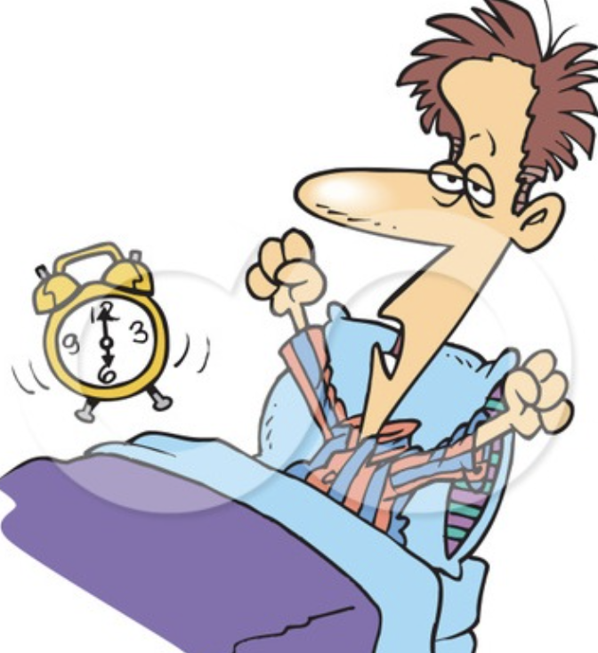
Step of Consciousness
(منزلة اليقظة)
I need to wake up from heedlessness and prepare for the hereafter

Slide 10
In our Journey, Prepare for a war with our “Nafs” (self, desires, distractions ..), and “Shaytan” (Satan, Devil, evil ..)

Slide 11
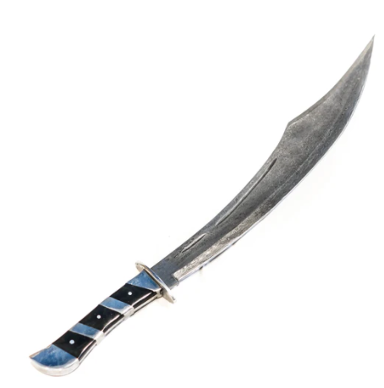

Slide 12
Duaa الدعاء
Zikr الذكر

Slide 13
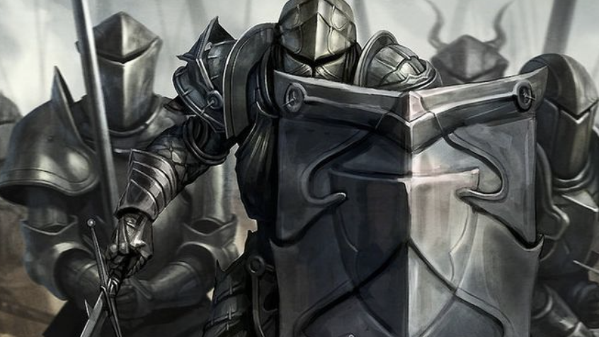
An Army (Good company)
This Friday Halaqa

Slide 14
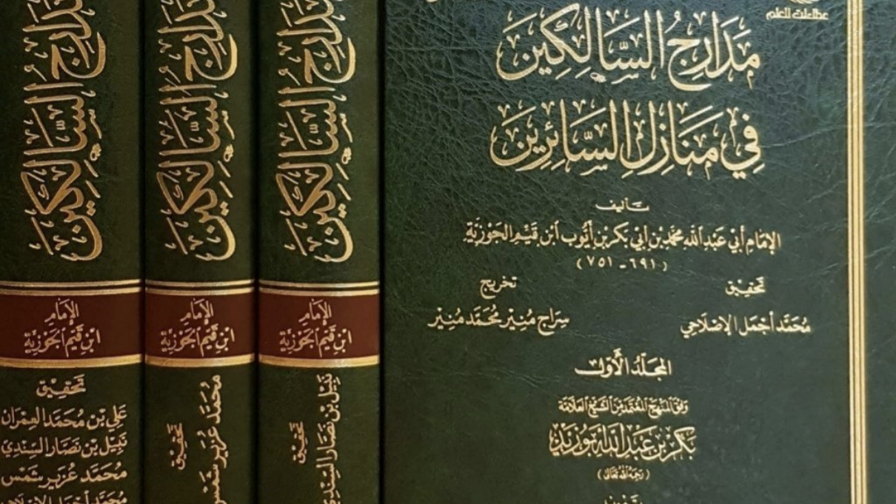
A Plan, a map, and a guide (Steps of the travelers)

Slide 15
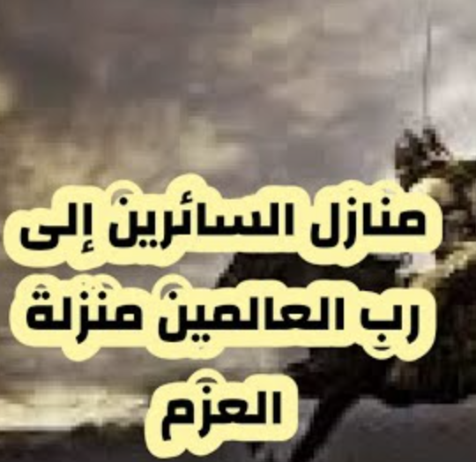
Step of commitment (العزم منزلة )
We need to commit today to walk together and do not stop no matter what happens
We need to commit to help each other

Slide 16
Plan
Gather a committed group
Commit
Follow the book. Each week go up one step isA

Slide 17
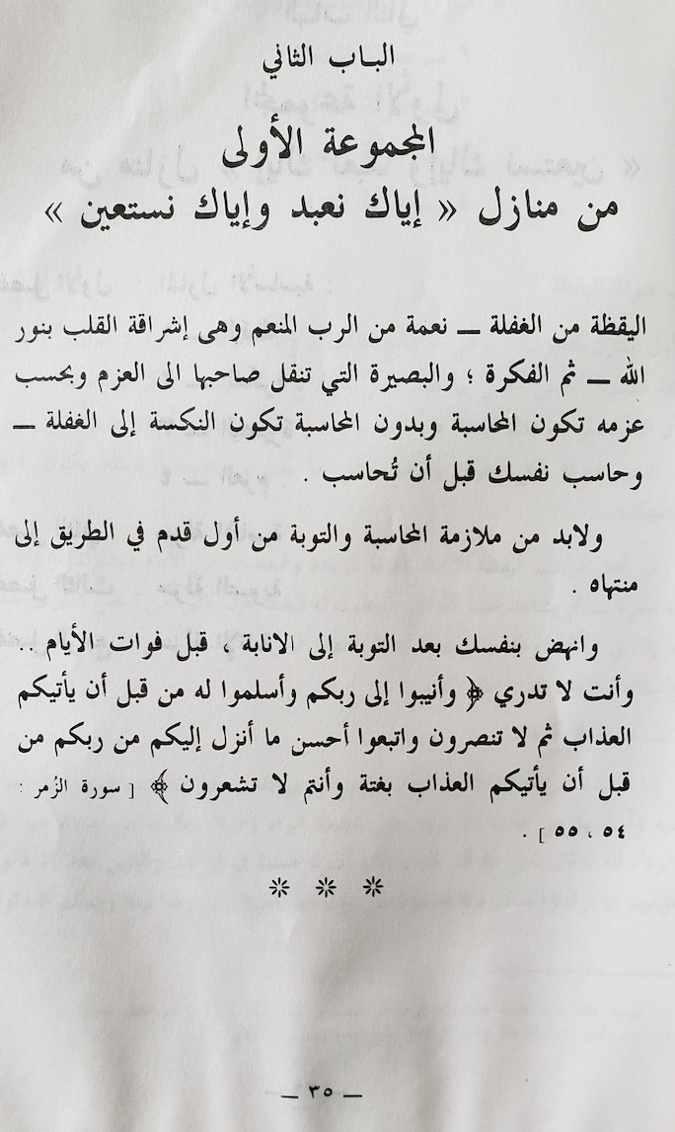
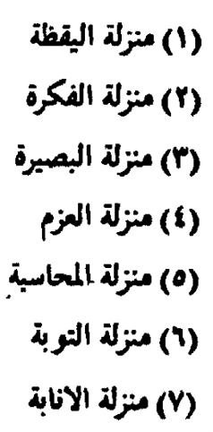

Slide 19
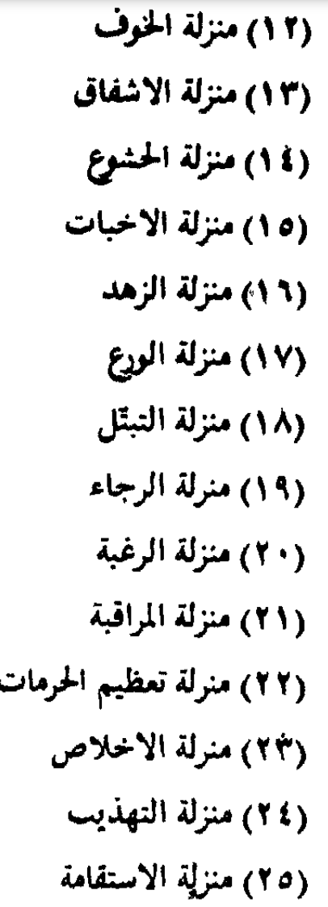
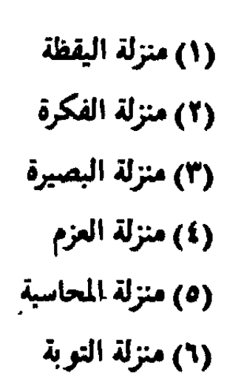
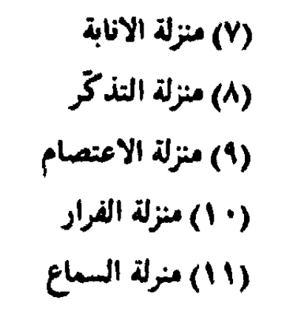

Slide 20
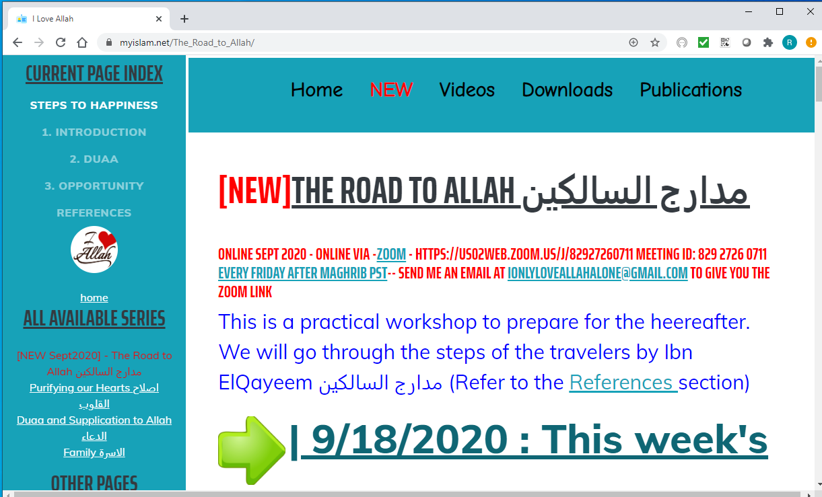

Slide 21
Discussion

Slide 22
The Prophet (PBUH) said who ever share something good Will get the same reward as who started it and It will keep multiplying until day of judgment Please, share to multiply the Reward isA. When you subscribe, Like, and share you allow others to find it, isA
Website:
https://iloveallah.net
YouTube Channel:
https://www.youtube.com/channel/UCZDYWIWY1pMaGg4-iw3uz1w

